Slide 1
Week 5
English 5th grade

Slide 4
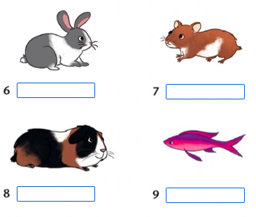

Slide 10
