Slide 1
English
6th grade (Week 4)

Slide 2
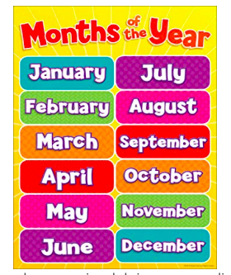

Slide 3
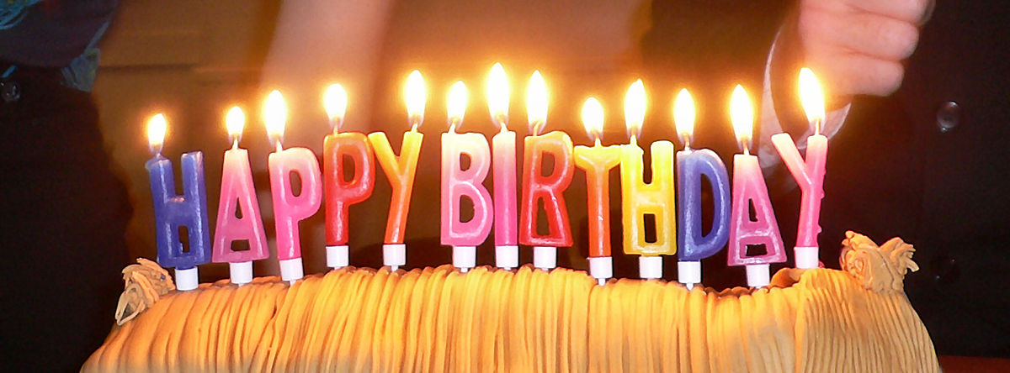
What month is your birthday?
My birthday is in June
Esta foto de Autor desconocido está bajo licencia CC BY-SA

Slide 7
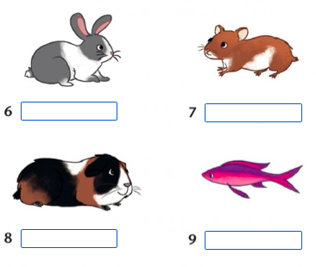

Slide 13
