Slide 1
English
5th grade (Week 4)

Slide 2
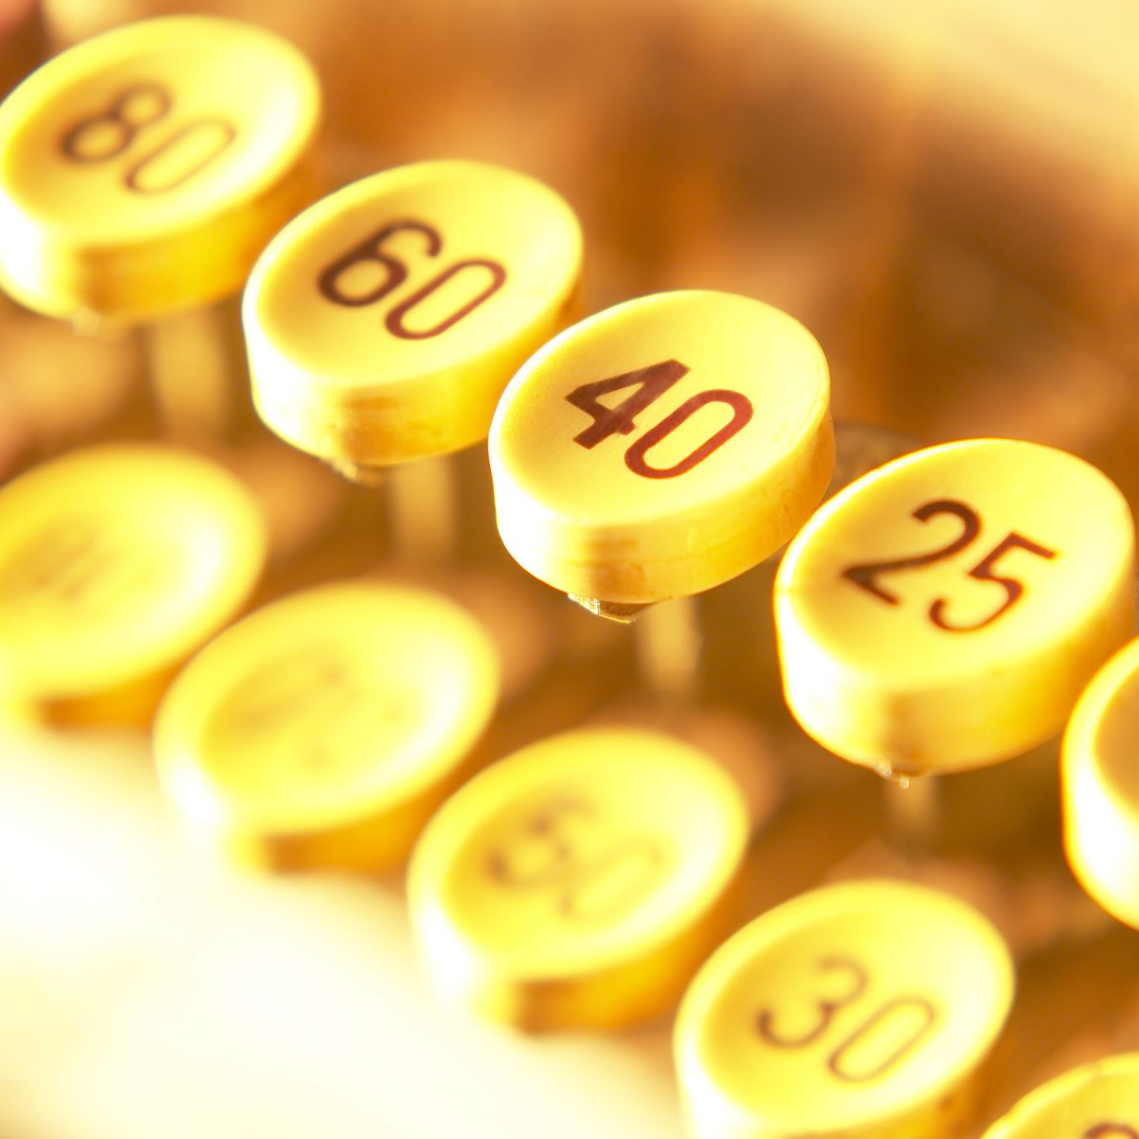
Write the following numbers in English
22
34
46
53
67
76
89
98
200

Slide 4
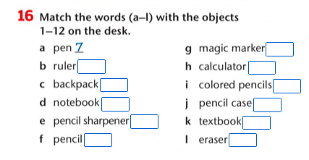

Slide 5
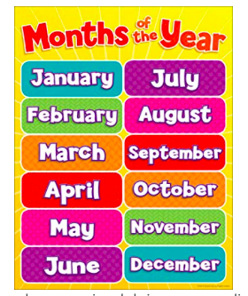

Slide 6
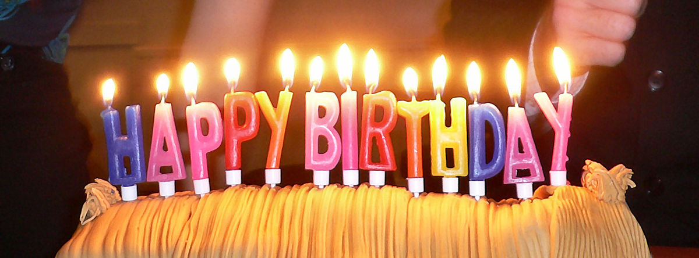
What month is your birthday?
My birthday is in June
Esta foto de Autor desconocido está bajo licencia CC BY-SA

Slide 10
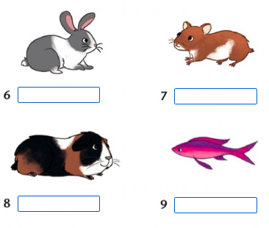

Slide 16
