Slide 1


English JUNIOR YEAR
TEACHER DANIELA VALENZUELA REYES
DVALENZUELA@EMMANUEL.CL

Slide 2

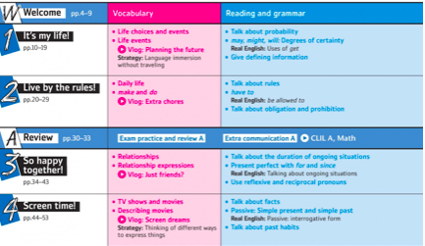
Units

Slide 3
Evaluations
Quizzes (regular verbs)
Tests
Work in Class
Reading comprehension
Videos (oral presentations)

Slide 4
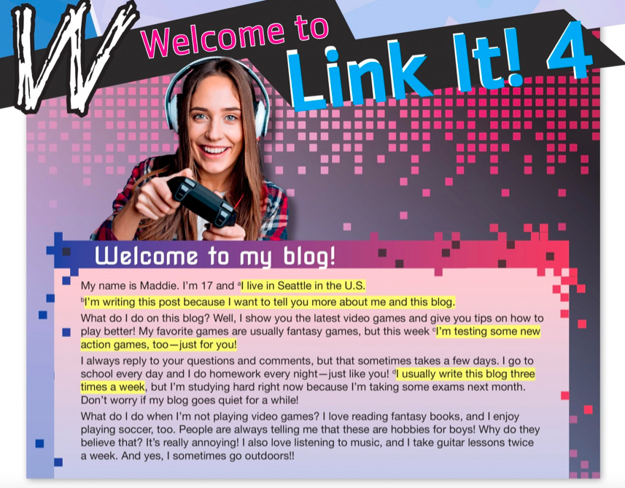

Slide 5


Slide 6
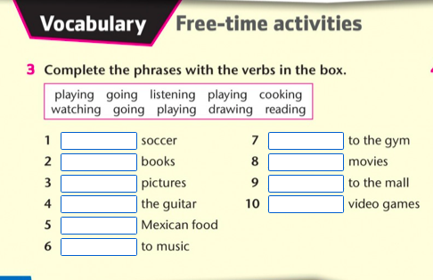

Slide 7
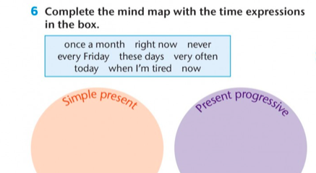

Slide 8
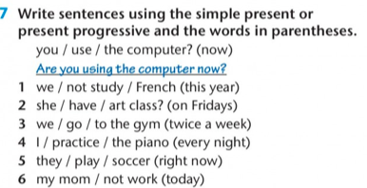

Slide 9
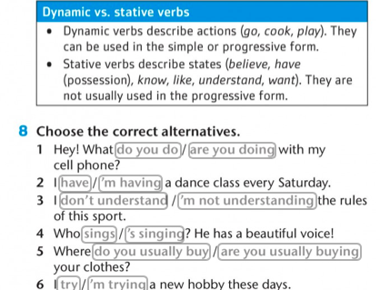

Slide 10
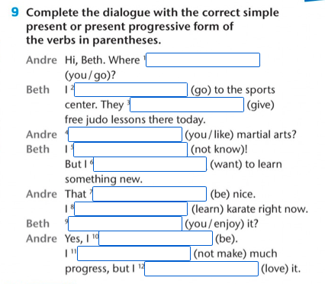

Slide 11
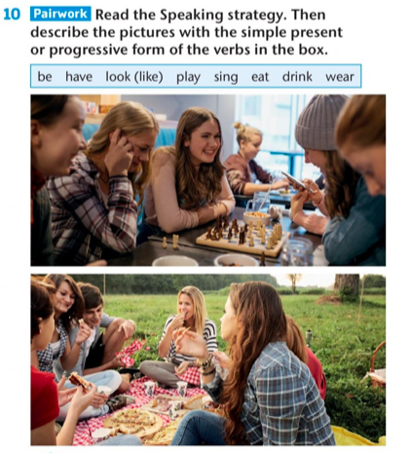

Slide 12
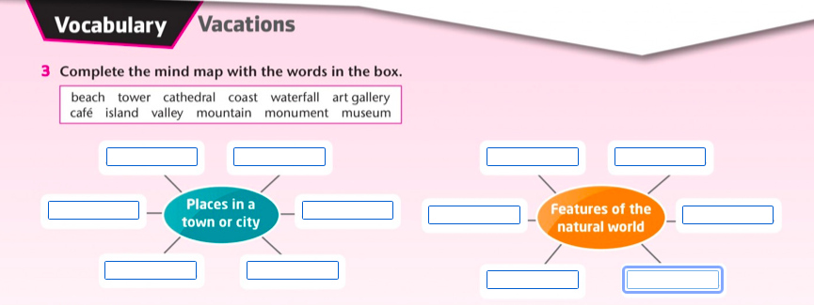

Slide 13
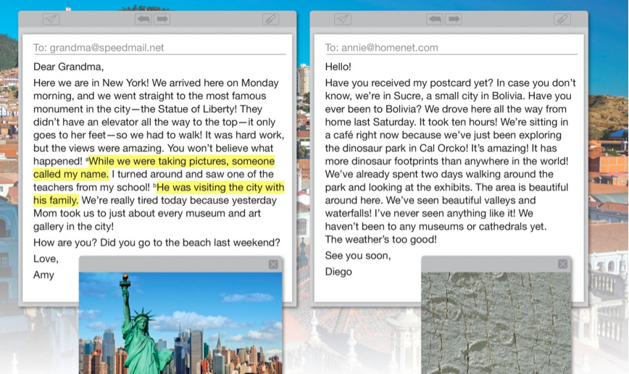


Slide 14
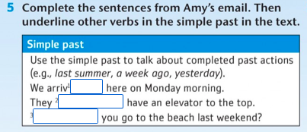

Slide 15
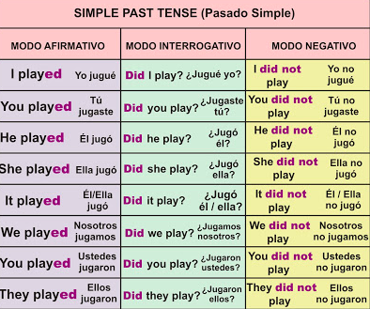
Past tense

Slide 16
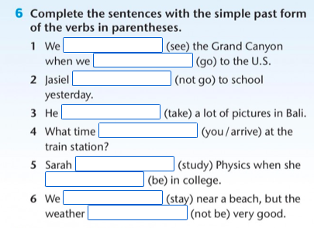

Slide 17
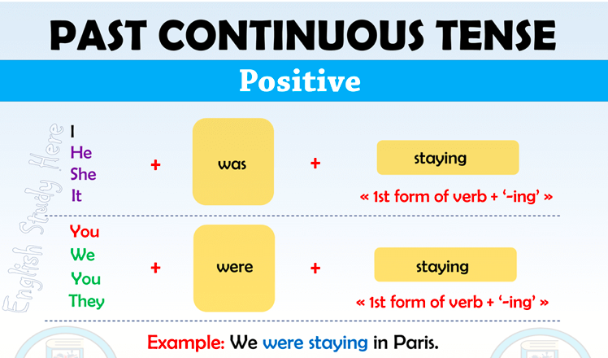
Past Progressive

Slide 18
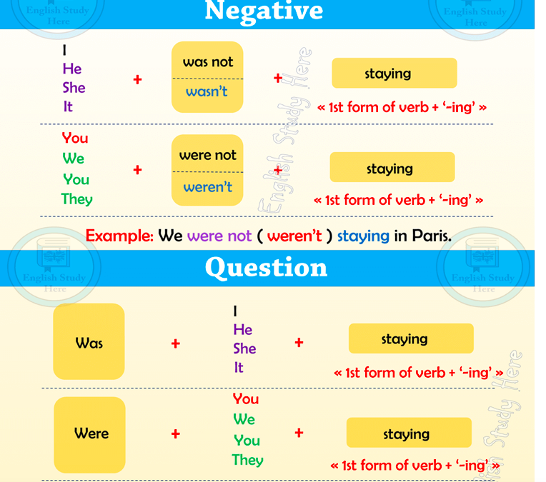

Slide 19
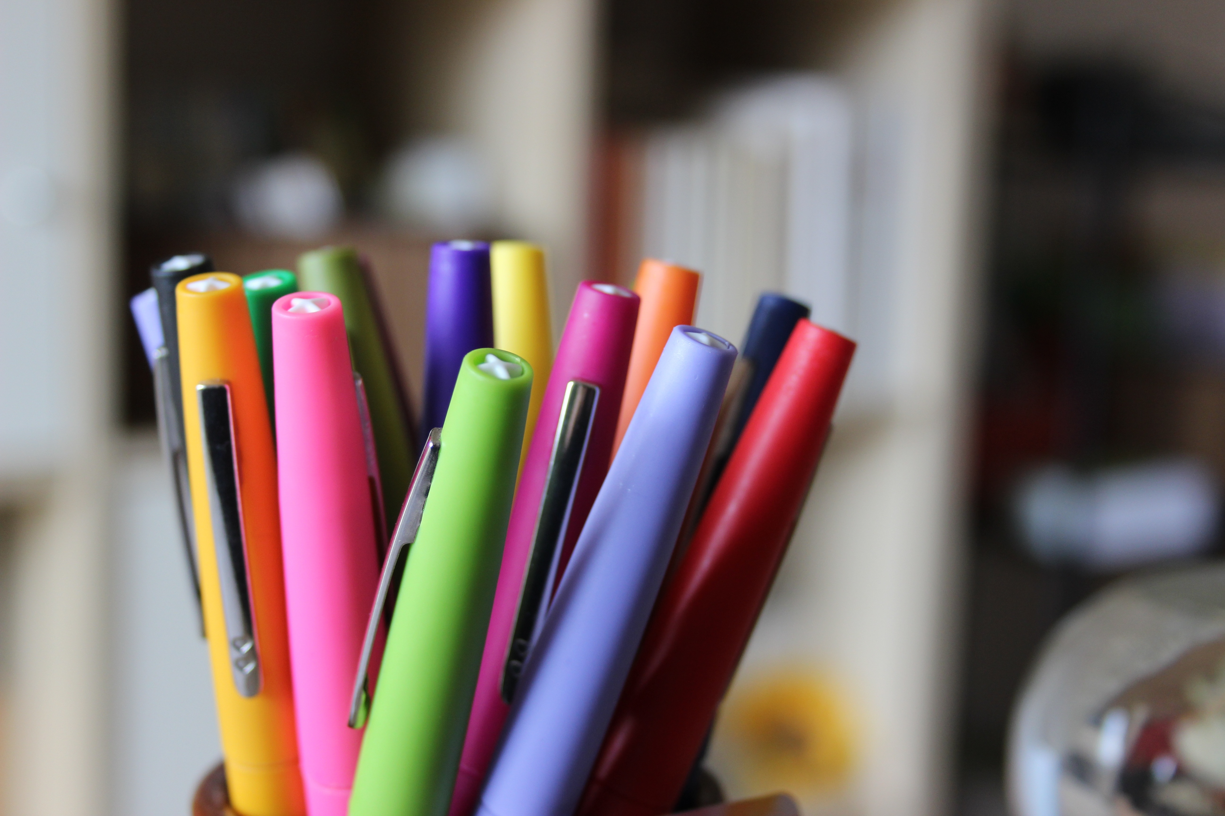
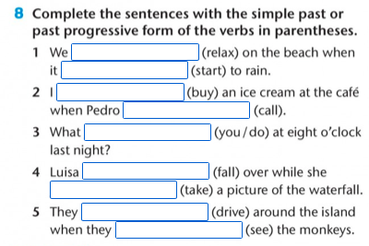
ACTIVITY

Slide 20
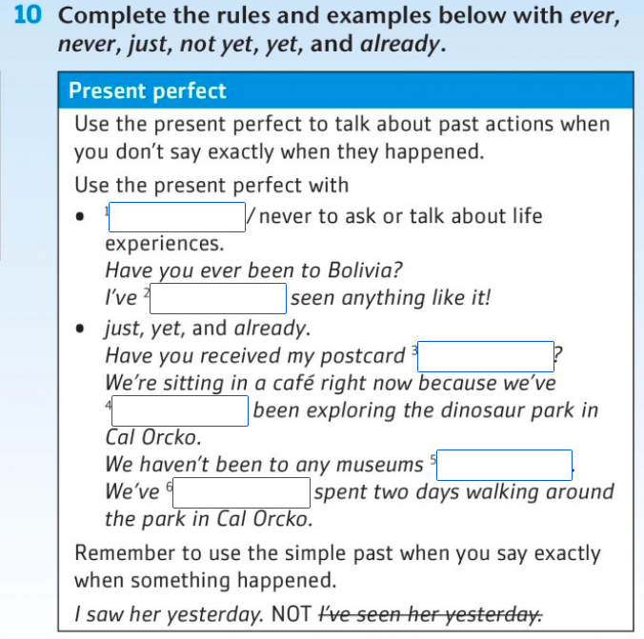

ACTIVITY 2

Slide 21
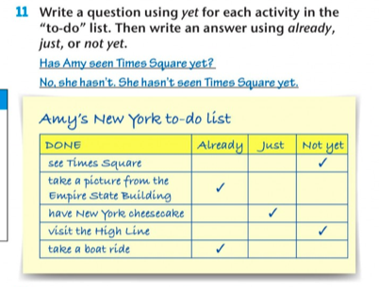
ACTIVITY 3

Slide 22

Activity 4

Slide 23
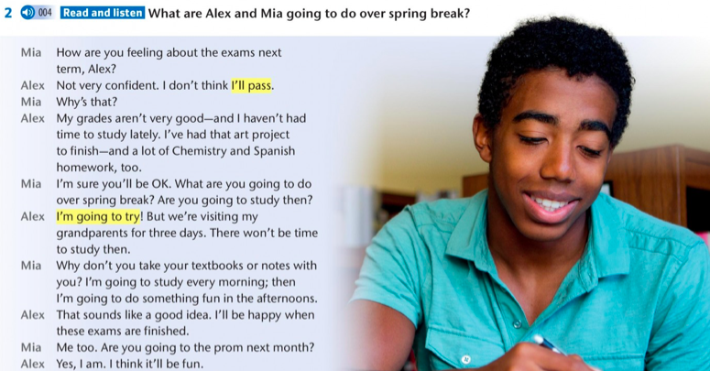

Slide 24

Activity 4

