Slide 1
PowerPoint 2
Past Simple and Past Continuous

Slide 2
Past tense

Slide 3
Past Progressive

Slide 5
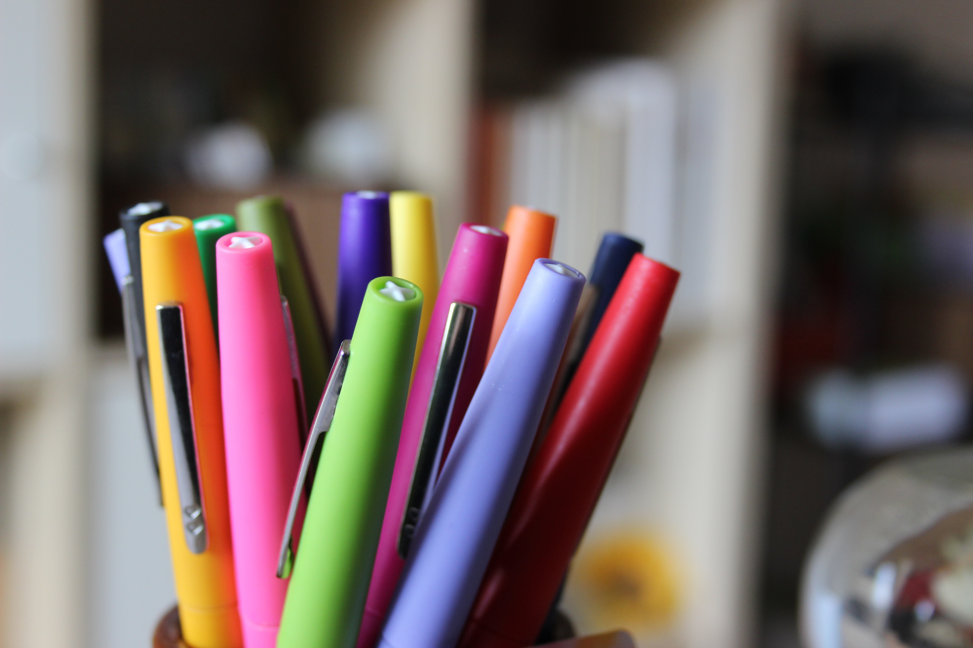
ACTIVITY

Slide 6
ACTIVITY 2

Slide 7
ACTIVITY 3

Slide 8
Activity 4

Slide 10
Activity 4

