Slide 1
Activities part 2

Slide 2
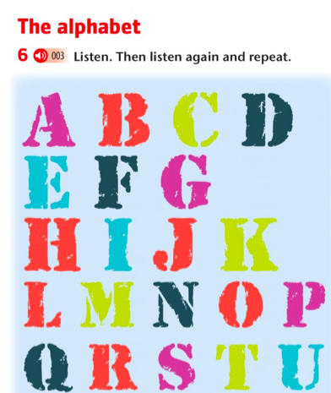
1. Write the sound of the alphabet
V = VI
W = DABLIU
X = EKS - EX
Y = WAY
Z =Zet
JUDITH = LLEI- IU- DI-AI- TI - EICH
2. Spell your name in English
(Spell: Deletrea)

Slide 4
Spell these words now
1. Lemon
2. Yellow
3. Good
4. Hello
5. mountain
6. thinking
7. Zip
8.Dices
9. Shark
10. Unicorn

Slide 6
