Slide 1
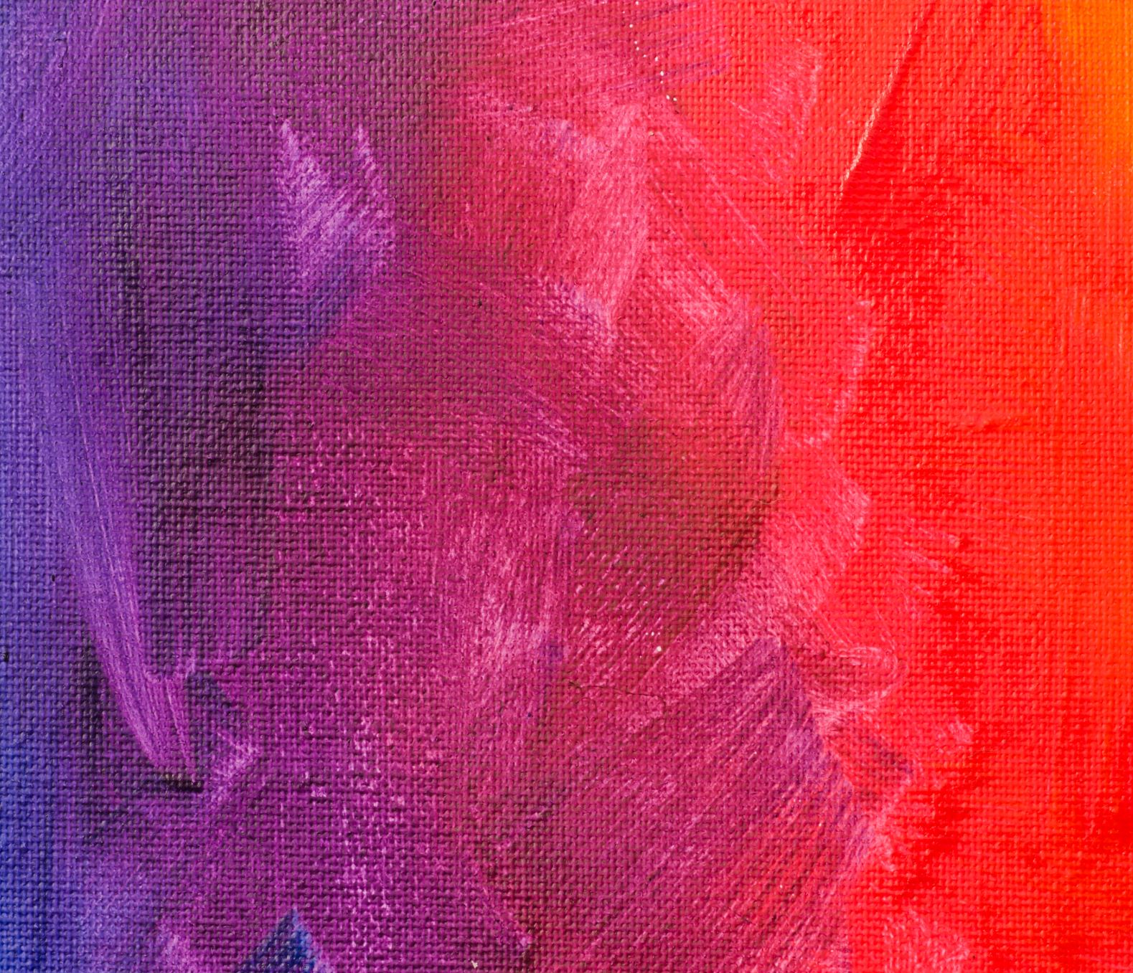
ACTIVITIES PART 2
Alphabet and numbers

Slide 2
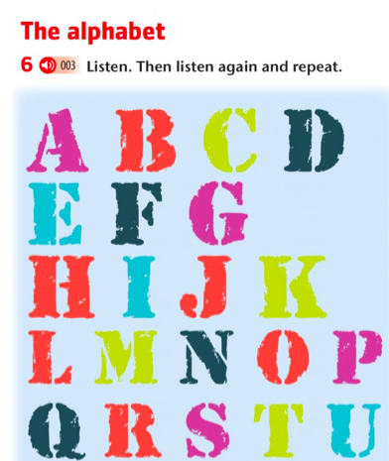
V W(DABLEIU ) X (EX-EKS) Y (WAI) Z (ZET)

Slide 3
Spell (deletrear) your name Judith = llei- iu- di- ai- ti- eich

Slide 5
Number by 10

Slide 6
Write the following numbers in English
22
34
46
53
67
76
89
98
200

