Slide 1


English JUNIOR YEAR
TEACHER DANIELA VALENZUELA REYES
DVALENZUELA@EMMANUEL.CL

Slide 2

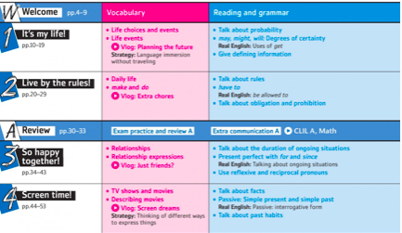
Units

Slide 3
Evaluations
Quizzes (regular verbs)
Tests
Work in Class
Reading comprehension
Videos (oral presentations)

Slide 4
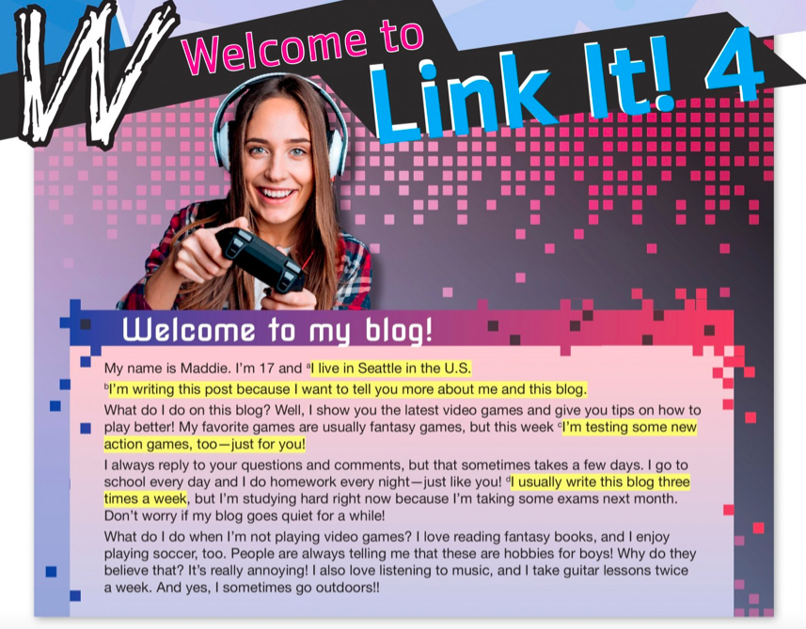

Slide 5


Slide 6
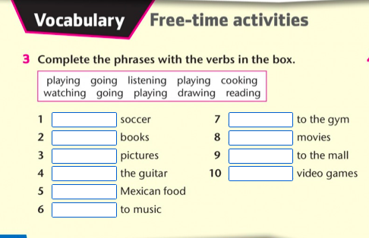

Slide 7
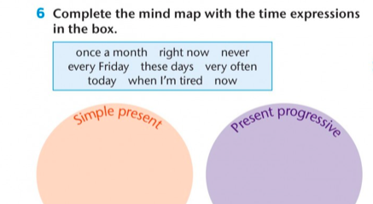

Slide 8
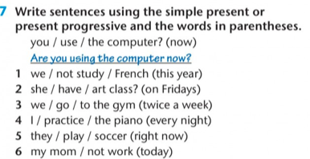

Slide 9
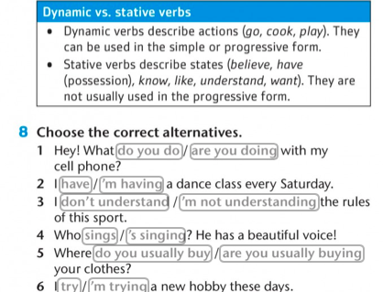

Slide 10
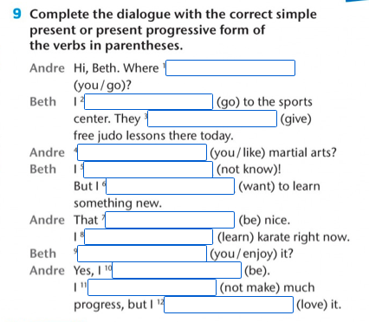

Slide 11
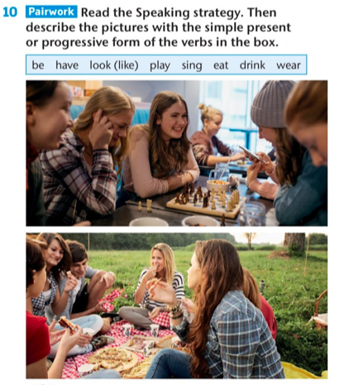

Slide 12
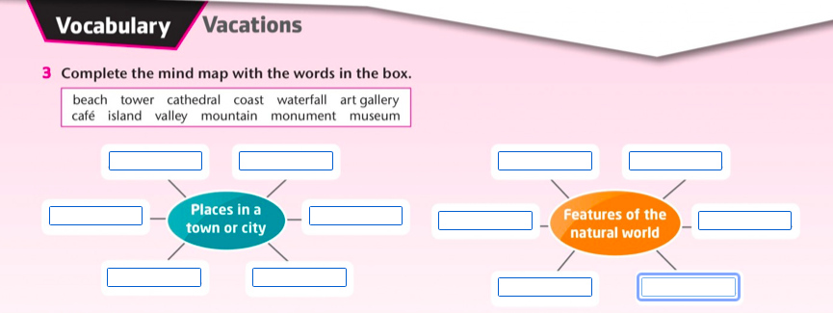

Slide 13
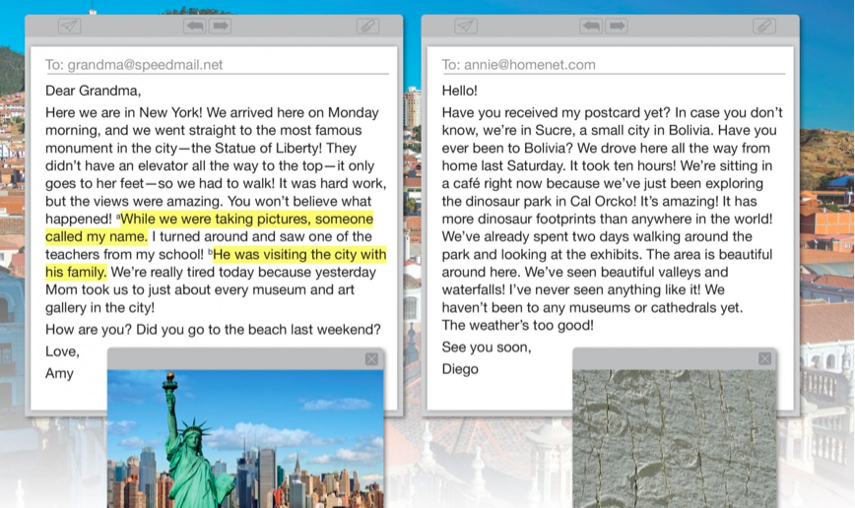


Slide 14
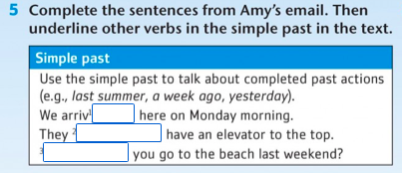

Slide 15
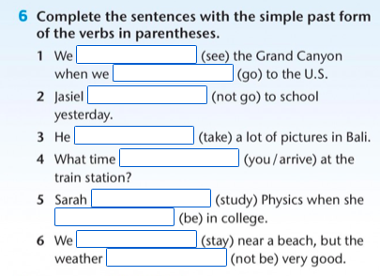

Slide 16
