Slide 1
English Freshmen year
Teacher Daniela Valenzuela Reyes
dvalenzuela@emmanuel.cl

Slide 2
Units

Slide 4
Evaluations
Quizzes
Work in class
Readings
Videos
Tests

Slide 5
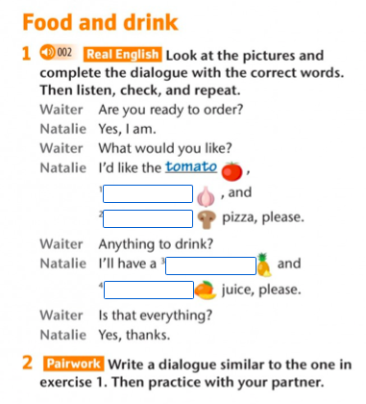
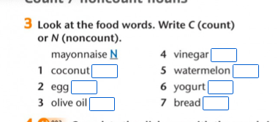
Activity 01

Slide 6
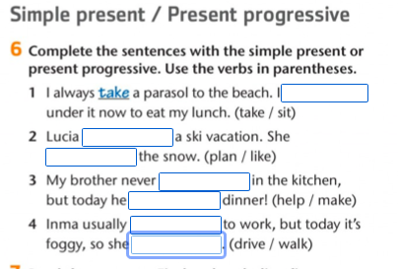

Slide 7
