Slide 1
English Senior Year
Teacher Daniela Valenzuela Reyes

Slide 2
Link it 4 B

Slide 3
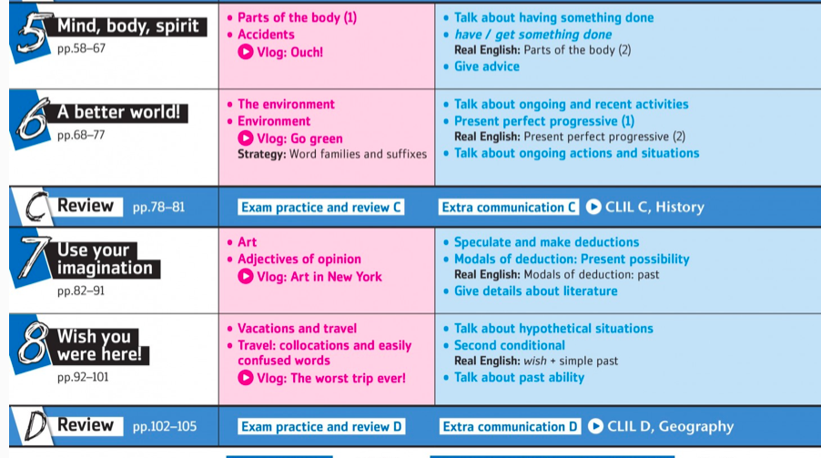
UNITS

Slide 5
EVALUATIONS
TESTS
WORK IN CLASS
READINGS
QUIZZES
ORAL VIDEOS

Slide 6
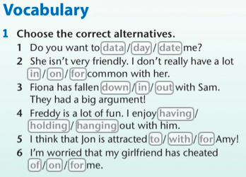

Slide 7
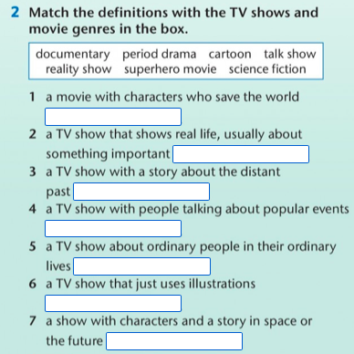
Activity 2

Slide 8
Activity 3

Slide 9
Activity 4

