Slide 1
English 7th grade
Teacher Daniela Valenzuela Reyes
Dvalenzuela@emmanuel.cl

Slide 2
Evaluations
Work in class
Tests
Quizzes
Recorded evaluations (grabaciones)

Slide 3
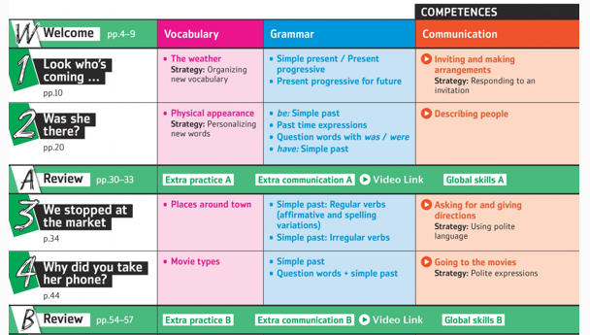
Units

Slide 4
Activities

Slide 12
