Slide 1
English Senior Year
Teacher Daniela Valenzuela Reyes

Slide 2

Link it 4 B

Slide 3

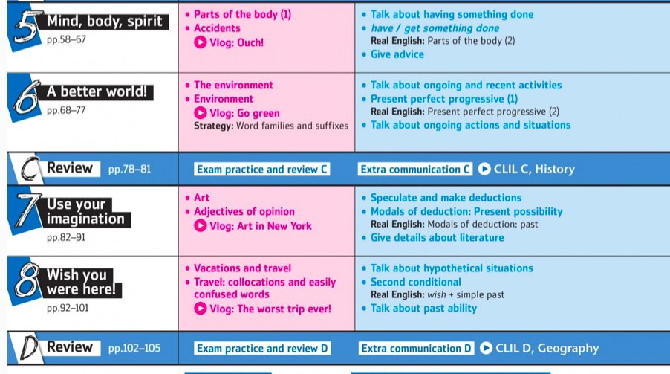
UNITS

Slide 4
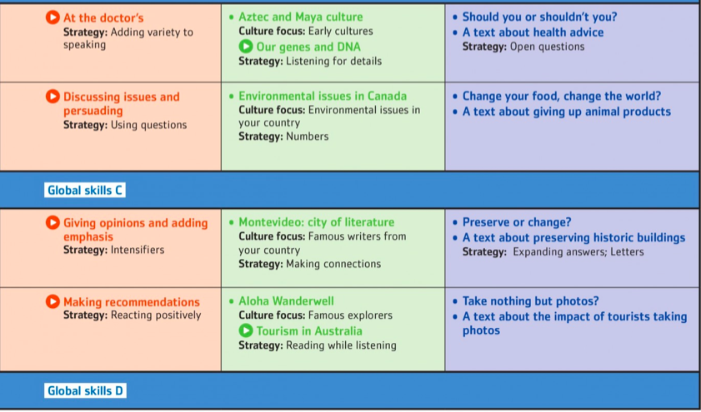

Slide 5
EVALUATIONS
TESTS
WORK IN CLASS
READINGS
QUIZZES
ORAL VIDEOS

Slide 6

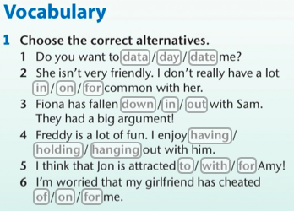

Slide 7
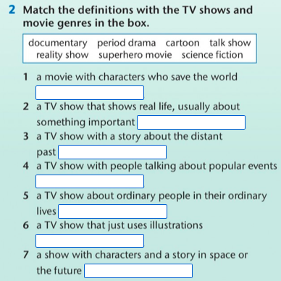
Activity 2

Slide 8
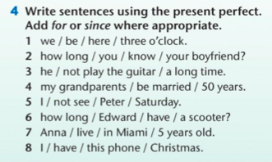

Activity 3

Slide 9
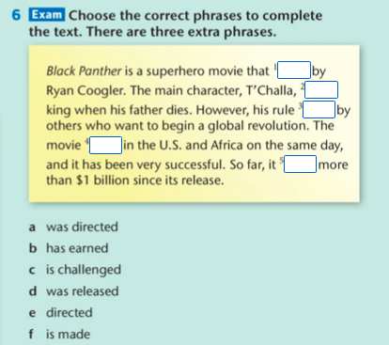
Activity 4

