Slide 1
8th grade English
Teacher: DANIELA VALENZUELA
dvalenzuela@emmanuel.cl

Slide 2
Units

Slide 3
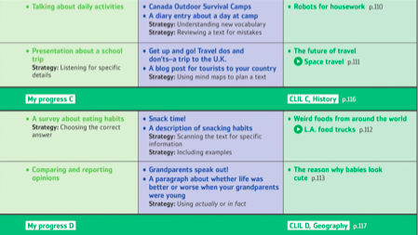

Slide 4
Activities

Slide 6
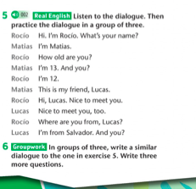

Slide 7
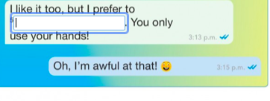
Sports activities

Slide 9
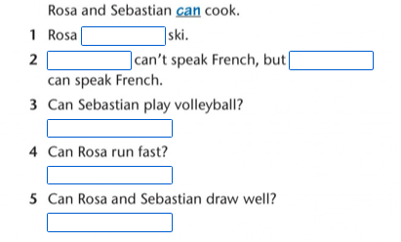

Slide 13
