Slide 1
6th grade english
Teacher Daniela valenzuela reyes
DVALENZUELA@emmanuel.cl

Slide 2
What do you remember?
Emotions
Members of the family
Parts of the house
Elements of the house
Places of the city
Nature

Slide 3
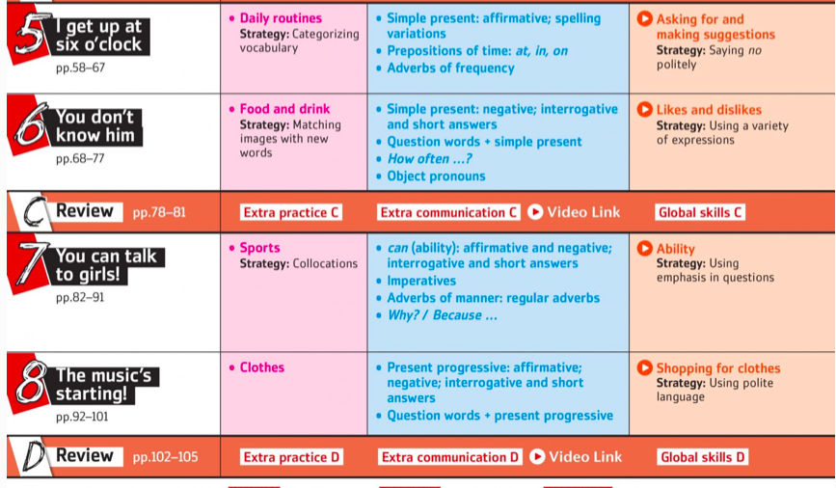
Units

Slide 5
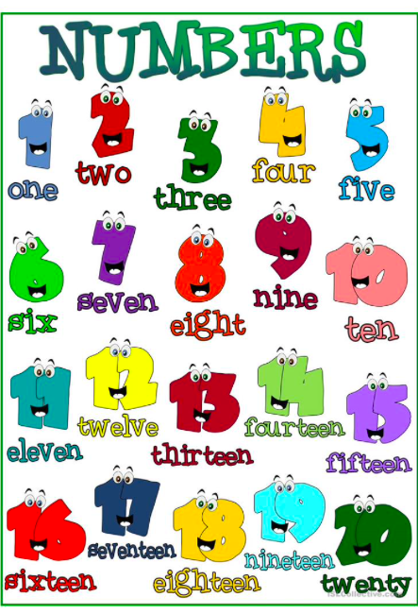
Telling the time
Numbers!!!

