Slide 1
5th grade English
Teacher: Daniela Valenzuela
E-mail dvalenzuela@emmanuel.cl

Slide 2
Units

Slide 4
Classroom language
Good morning, good afternoon
Hello, Hi,
Please
How are you?
I have a questions, teacher
I need help
Can I go to the toilet, please?
Good bye, Bye, Bye bye

Slide 5
Class instructions
Open your book
Read
Look
Listen
Sit down
Talk
Write
Listen
Can i ….?
Talk to my partner
Go to the board
Use a red pen
Go to the restroom

Slide 6
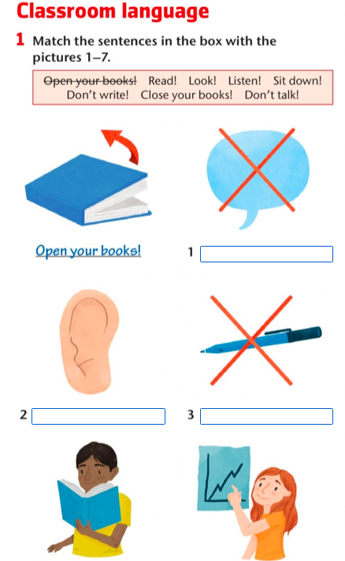
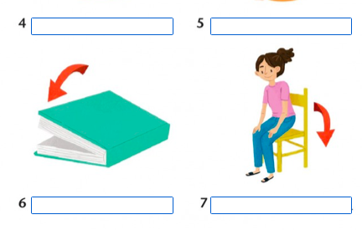
aCTIVITIES

Slide 7
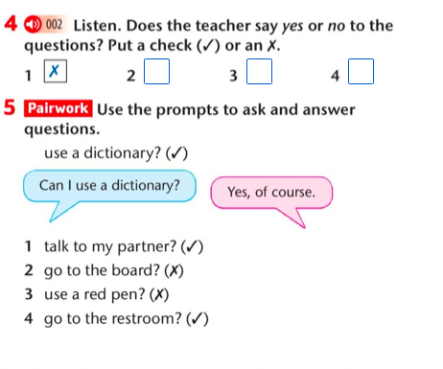
Activities

Slide 8
iNTRODUCING YOURSELF
Hello everyone, My name is Daniela, I am 30 years old. I live in Pudahuel with my family. My favourite colours are purple and emerald green. I love music, books and movies. I have a dog, his name is Chester.
Nice to meet you all

