Slide 1
Going to
Daniel Salinas Lagos
Colegio Cristiano Emmanuel

Slide 2
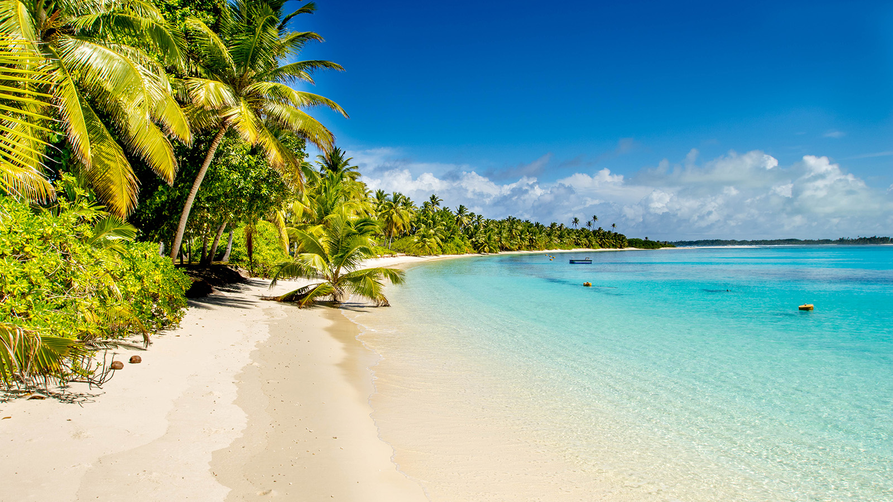
How to abbreviate our sentences
We have been learning how to use “going to” correctly.
Now, we are going to learn how to make our sentences a little bit shorter.
For this, we eliminate the “going to” from our sentence and, instead, we add “-ing” at the end of the verb we will use.
E.g.
I am going to travel to the beach by car.
I’m travelling to the beach by car.

Slide 3
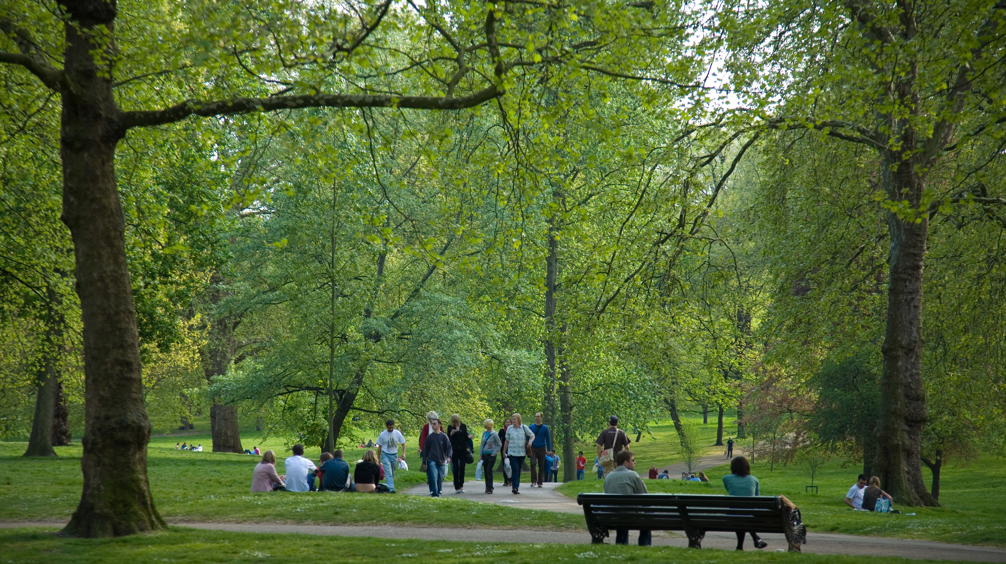
More examples
Sofia is going to spend the day in the park.
Sofia is spending the day in the park.
Pablo and Zach are going to go to the cinema.
Pablo and Zach are going to the cinema.
I’m not going to arrive home until Friday.
I’m not arriving home until Friday.

Slide 4
Activity: Writing a letter
You are going to write a letter to some friend to tell him or her your plans for this week (at least 3 activities you are planning to do this week).
To accomplish this, you are going to use “going to” (including what we learned today).
In the next slide, I will show you an example of what you have to do.

Slide 5
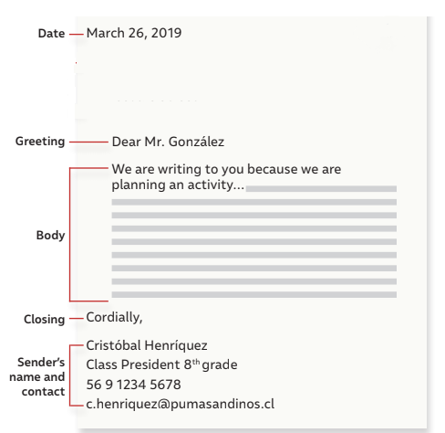
November 12, 2020
Dear Thomas,
I’m writing to you to tell you my plans for this week. On Monday, I’m travelling to the beach with my family. We are going to stay there the whole week because we are visiting my grandparents. There, we are celebrating my grandfather birthday. We are going to eat completos and play some games. I hope you have a great week too.
Regards,
Daniel

