Slide 1
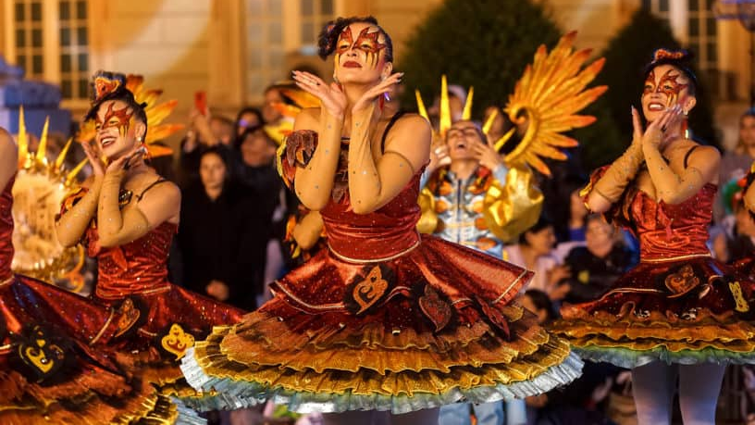
Activity:
Choose any tradition you might like.
Answer the following questions:
a) What is the name of the tradition?
b) Where does this tradition celebrate?
c) When does this tradition celebrate?
d) Why does it celebrate?
e) What do people do during this tradition?

Slide 2
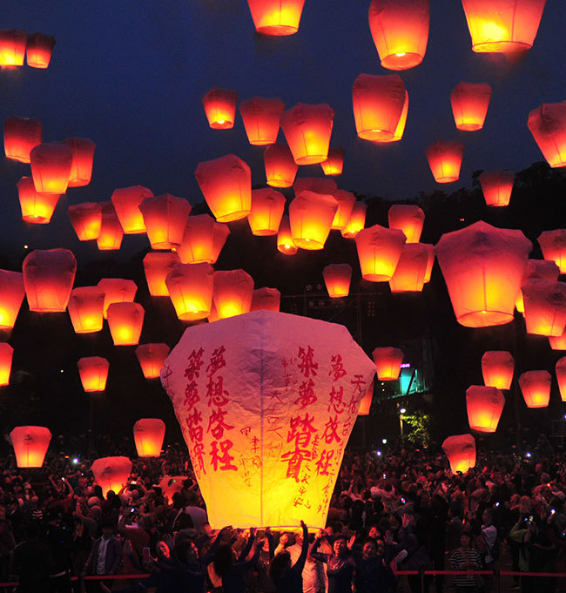
Example:
The Pingxi Latern Festival is a tradition celebrated in the small hillside town of Pingxi, Taiwan. Around the time of the first full moon sky lanterns are released to the heavens. These were once used as signals for villagers to let their families know they were safe and sound but now carry people’s wishes and hopes for the new year into the night sky.

