Slide 1
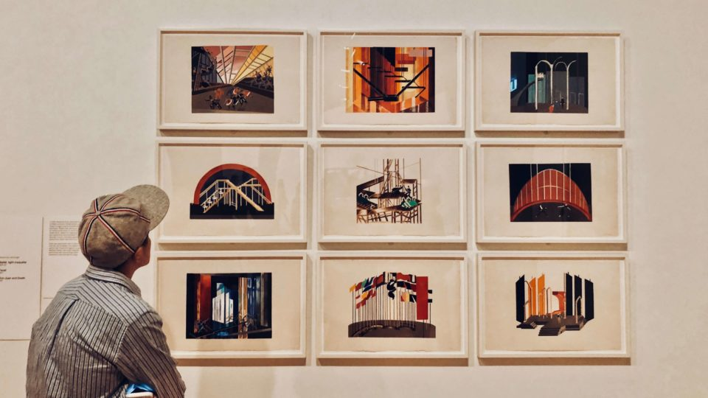
Going to
Daniel Salinas Lagos
NM1
Colegio Cristiano Emmanuel

Slide 2
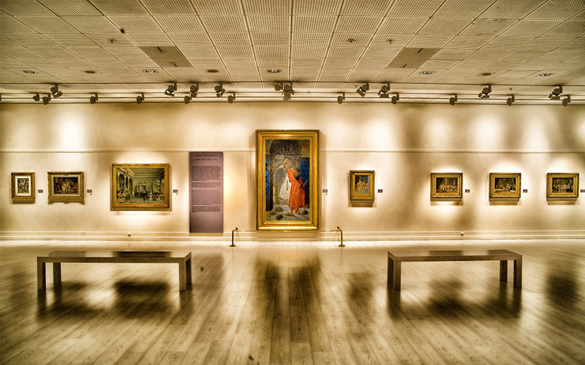
Why do we use “going to”?
We use “going to” to talk about our future plans and intentions. (Usually the decision about the future plans has already been made)
For example,
I’m going to go to a concert this weekend.
I’m going to visit an art gallery now.
I’m going to write a new song.
You can also talk about other people’s future plans. For example,
Sabrina (she) is going to watch a movie tonight with me.
Thomas (he) is going to be the star of a new film.

Slide 3
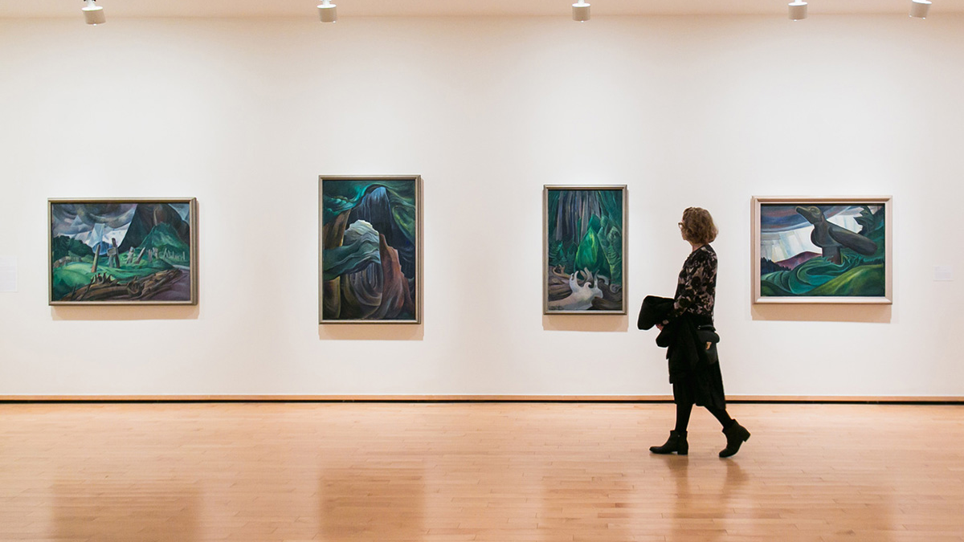
How do we use it?
To make sentences using “going to”, we follow the next structure:
Subject + Verb to be + “going to” + verb (inf) + complement
I am going to do some sightseeing
I Am
You
We Are
They
She
He Is
It

Slide 4
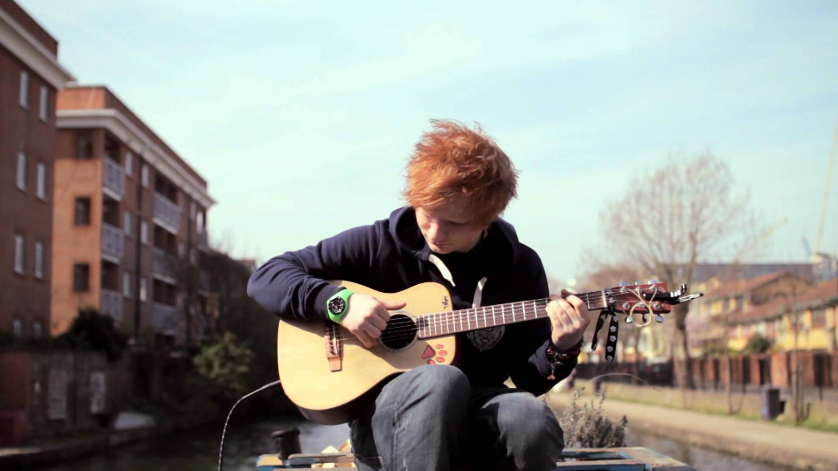
Negative Sentences
To make sentences in negative using “going to”, we simply add the “not” after the verb “to be”.
e.g.
I am NOT going to go to the concert this evening.
Tobey Maguire is NOT going to be part of the new Spider-man movie.
The new Ed Sheeran’s song is NOT going to be released until next year.

Slide 5
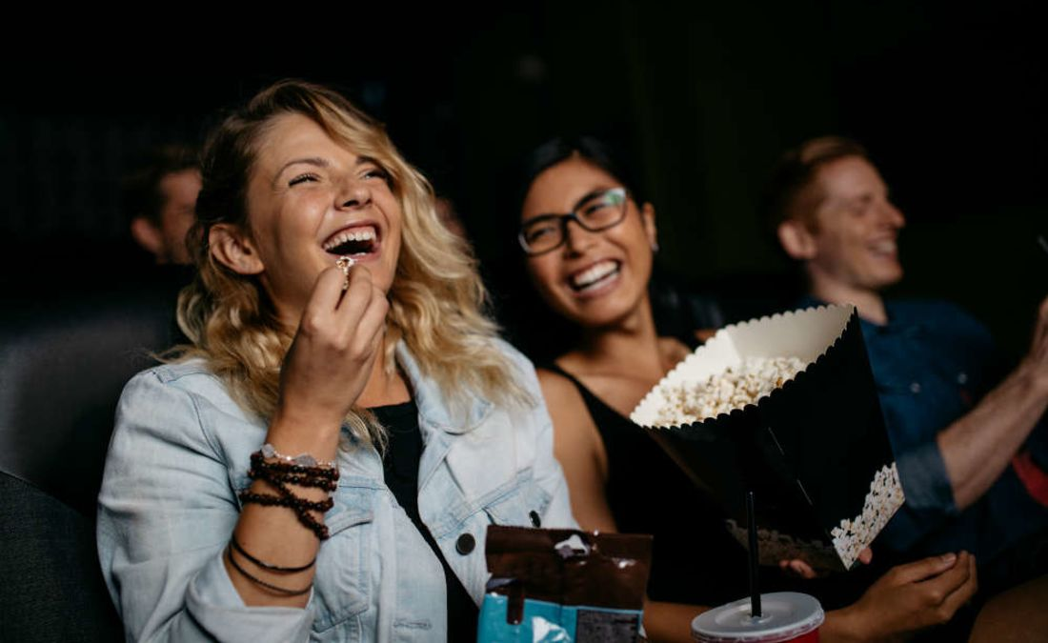
Questions
To make questions, we follow this structure:
Verb “to be + Subject + “going to” + Complement
Are we going to the art gallery together?
Is Samuel L. Jackson going to be in the new Tarantino film?
We can also use this structure with “Wh-questions”.
What are you going to do this weekend?
I’m going to go to the art gallery with my friend.
Where is Sofia going to go tomorrow?
She’s going to go to the cinema with Paul.

Slide 6
Example
Javier: Hey, Toni, what are you going to do this afternoon? I thought that maybe we could hang out in my house.
Toni: Sorry, I can’t. I’m going to go to a concert a little later. We can hang out tomorrow if you want.
Javier: I can’t. I’m going to go to an art gallery with my girlfriend. Apparently, Lira’s most famous paintings hang in the Central Gallery.
Toni: I didn’t know you liked art. How about next week, then? What are you going to do?
Javier: I’m not going to do anything on Tuesday. Maybe we can hang out that day.
Toni: Excellent. I’m not going to do anything either. Are we going to watch the last Fast and Furious film? I haven’t watched it.
Javier: That’s great. I heard that it is violent. I love violence in movies.
Toni: Really? That’s why I love action films so much! That’s amazing. See you next Tuesday then.
Javier: See you!

Slide 7
Activity: Create you own dialogue
Instructions:
Now, you have to create your own dialogue.
Your dialogue has to be related to the unit (The Arts).
Try to include the vocabulary we have seen before in the videos.
Include sentences using “going to” at least 5 times.
Here you have some vocabulary you can use: art gallery – cinema – concert – theater – music – sculpture – painting – films (action, horror, romance) You can also use some films vocabulary such as adjectives to describe films (violent, slow, moving) and vocabulary related to music such as parts of a song (intro, chorus) and musical instruments (guitar, bass, drums, keyboard)

