Slide 1
Describing films
Daniel Salinas Lagos
NM1
Colegio Cristiano Emmanuel

Slide 2
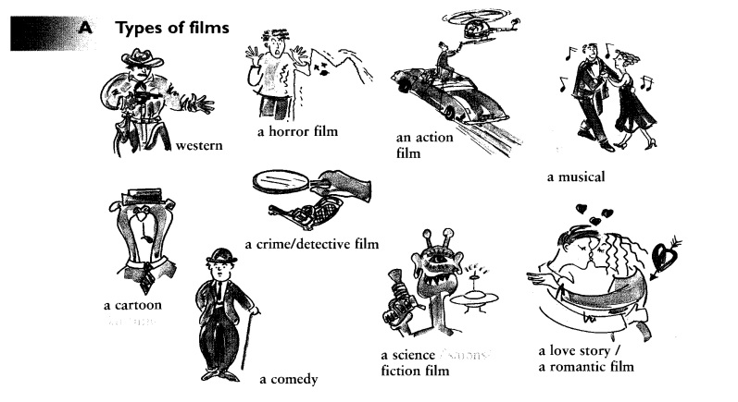
Genres

Slide 3
Rom-Com films

Slide 4
Describing a film
To describe we use adjectives.
We are going to learn some adjectives that are very useful to describe a film/movie.

Slide 5
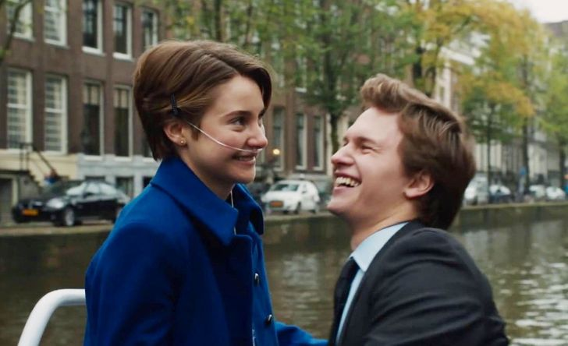
Some adjectives to describe a film
Moving: when a movie is moving, means that it produces strong emotions, often of sadness (although it is a positive word)
e.g. Romantic films are moving.

Slide 6
Some adjectives to describe a film
Powerful: This one is very similar to moving because, when a film is powerful, it means it has a big impact in your emotions and your life.
e.g. I consider the “Joker” movie a very powerful movie.

Slide 7
Some adjectives to describe a film
Violent: a violent movie includes a lot of fighting scenes, explosions, death, etc.
e.g. Action films are violent.

Slide 8
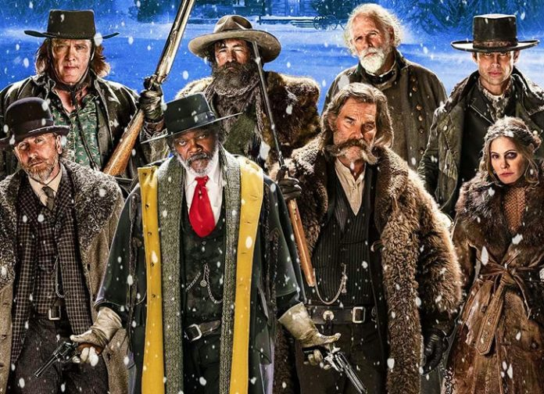
Some adjectives to describe a film
Gripping: When a movie is gripping, it means it is exciting and very interesting.
e.g. I consider western movies very gripping.

Slide 9
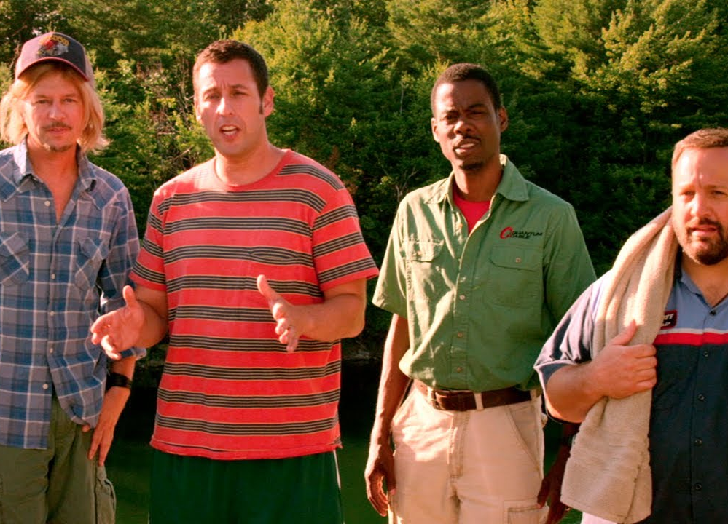
Some adjectives to describe a film
Good fun: Used to describe a film that may not be very serious or important but is enjoyable.
e.g. I find Adam Sandler movies good fun.

Slide 10
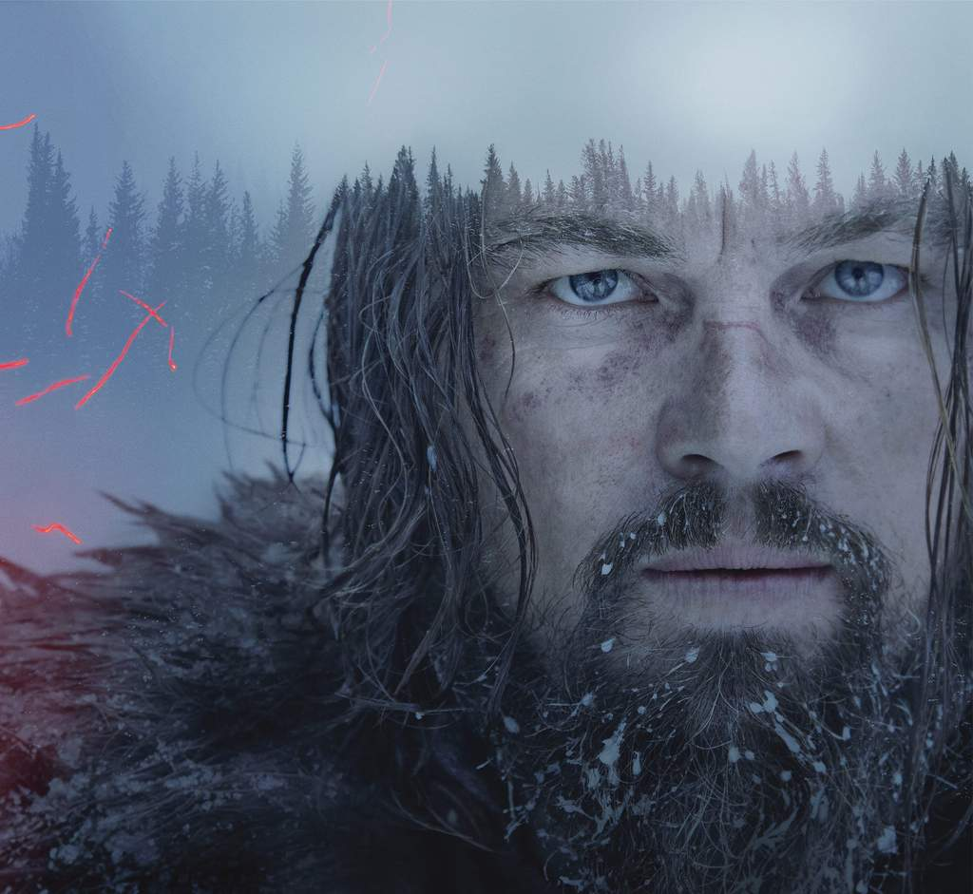
Some adjectives to describe a film
Slow: When you say a movie is slow, it means that you find it boring.
e.g. The Revenant is a very slow movie.

Slide 12
Activity
Choose 3 movies from the list shown in the next slide.
Write down the genre.
Choose an adjective (or more than one) from the ones seen today to describe the film.
Write a sentence using the adjective/s you chose for each movie.

Slide 13
Example
Title: Wonder
Genre: Drama, comedy
Description: moving, powerful
Sentence: I think Wonder is a very powerful, moving film.

Slide 14
List of movies
Mean Girls
To all boys I’ve Loved Before
Enola Holmes
Spider-man: Homecoming
Shrek
The Revenant
Baby Driver
La La Land
SAW
Star Wars
Harry Potter
The Conjuring

