Slide 1
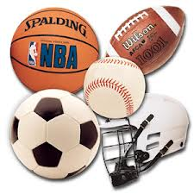
Do you like to play sports?
What ´s your favorite sport?
Do you like to watch the Olympic Games?

Slide 2

Olympic Sports

Slide 3
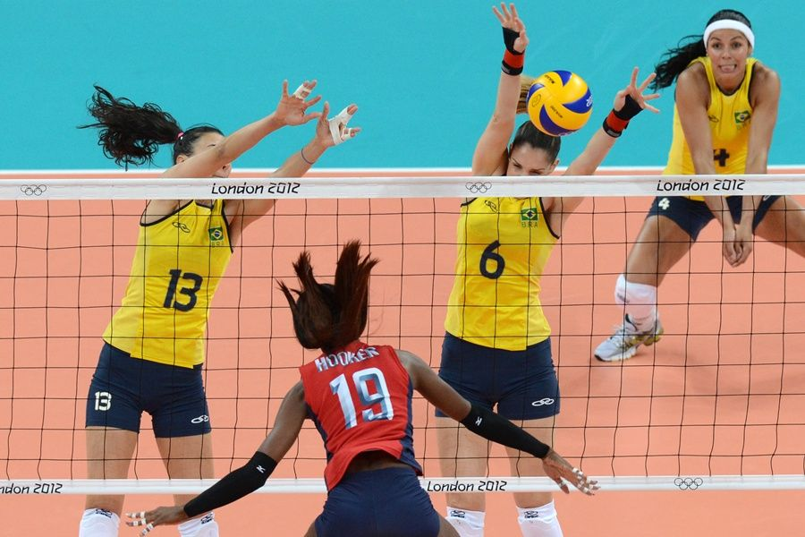
They are playing volleyball

Slide 4
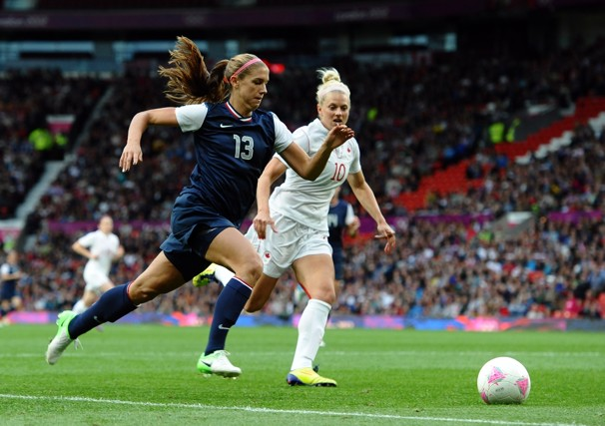
Alex Morgan is playing soccer

Slide 5
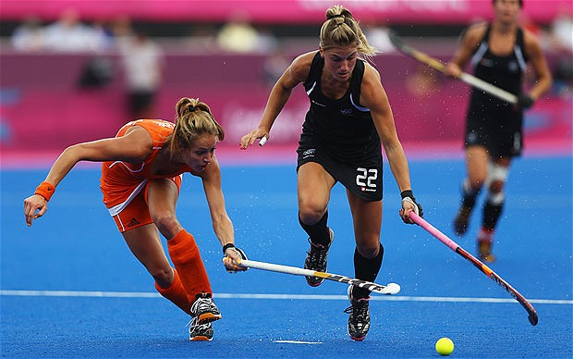
The ladies are playing hockey

Slide 6
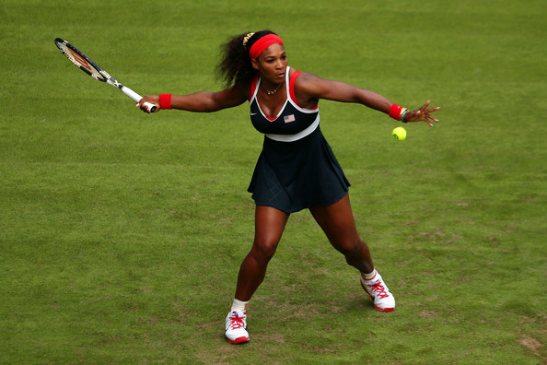
Serena Williams is playing tennis

Slide 7
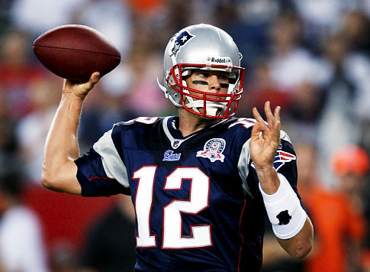
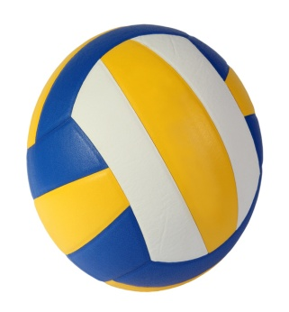
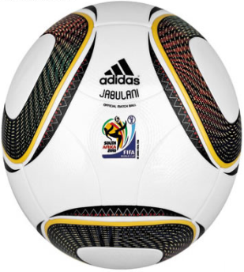
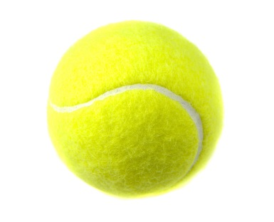
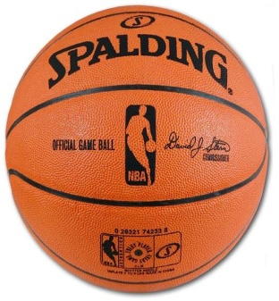
Playing
Is used with ball games or competitive games where we play against another person.
Tom Brady is playing football

Slide 8
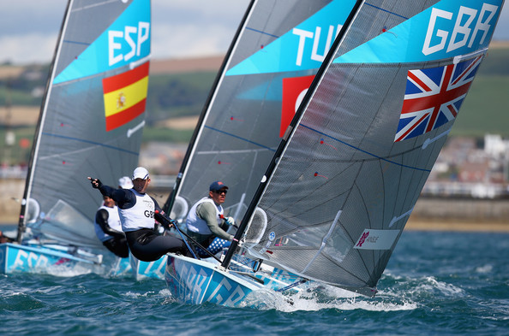
They are sailing

Slide 9
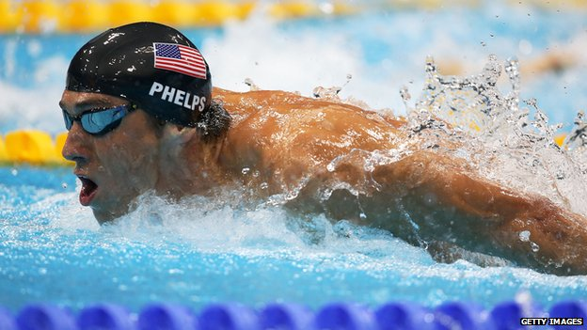
Michael Phelps is swimming

Slide 10
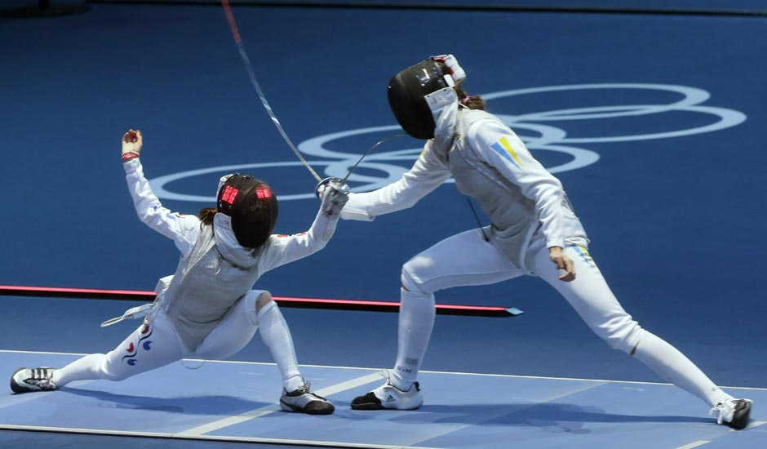
They are fencing

Slide 11
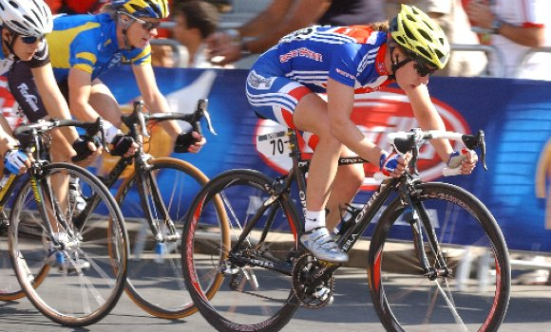
They are cycling

Slide 12
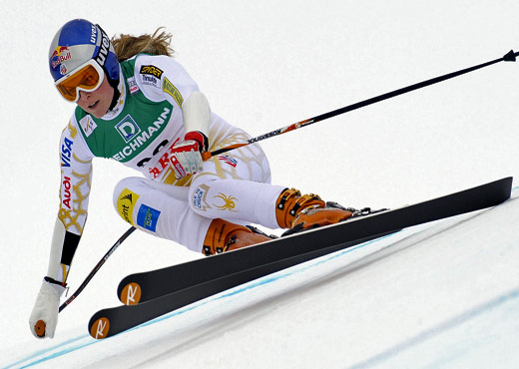
When someone is actively doing the sport you can say:
I am fishing
Lindsay Vonn is skiing
Go + ing
Is used with activities that end with ing.
We go somewhere to do something.
I go bowling every week

Slide 13
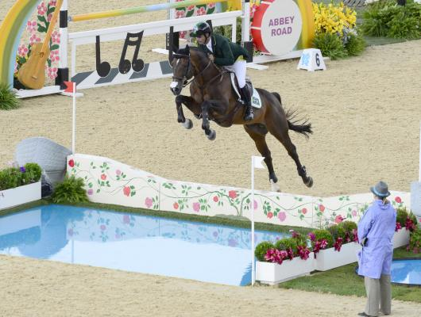
Rodrigo Pessoa is doing equestrian

Slide 14
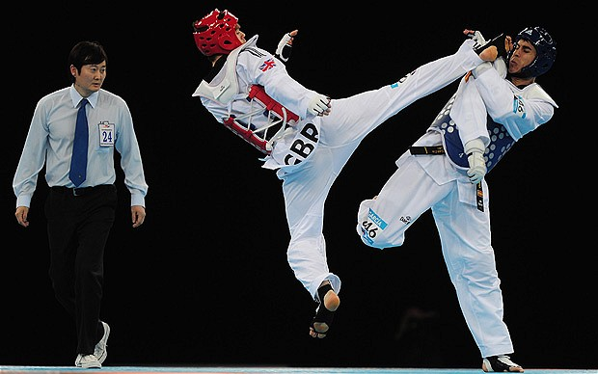
They are doing taekowndo

Slide 15
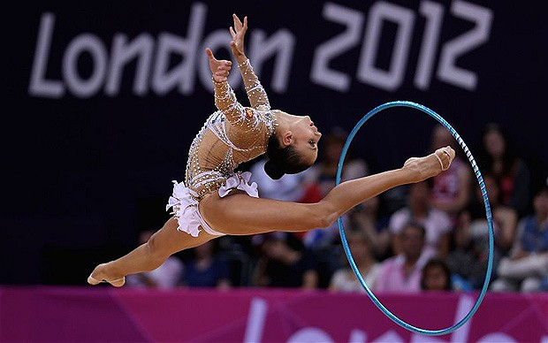
She is doing rhythmic gymnastics

Slide 16
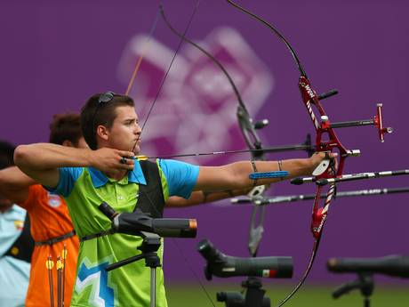
He is doing archery

Slide 17
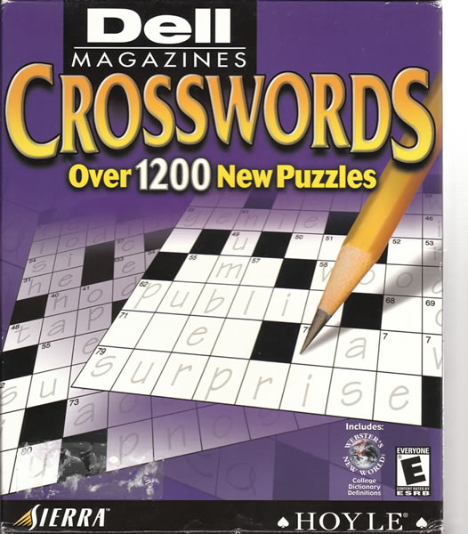
Do
Is used for recreational activity or non team sport that doesn´t use ball.
She does aerobics
He does crosswords puzzle in his free time

Slide 18

People engaged in these sports are:
Soccer player
Volleyball player
Hockey player
Tennis player
Sailor
Swimmer
Fencer
Cyclists or Bicyclists
Horserider
Taekwondo fighter
Rhythmic gymnast
Archer

Slide 19
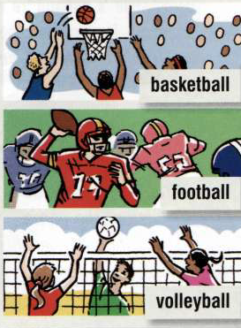
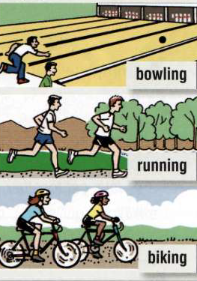
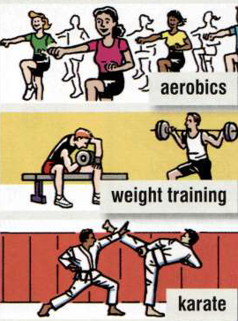
They are playing....
They are doing....
They are.....

