Slide 1
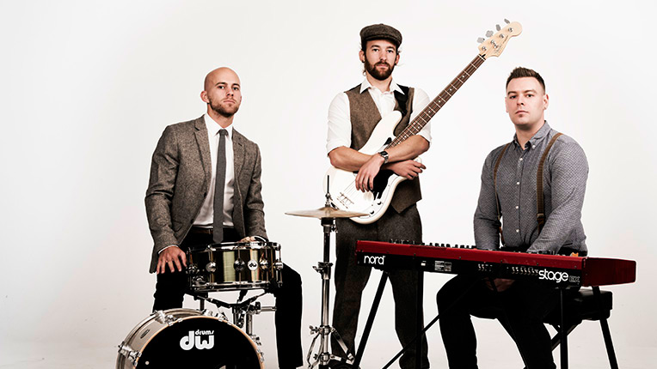
Music
Daniel Salinas Lagos

Slide 2
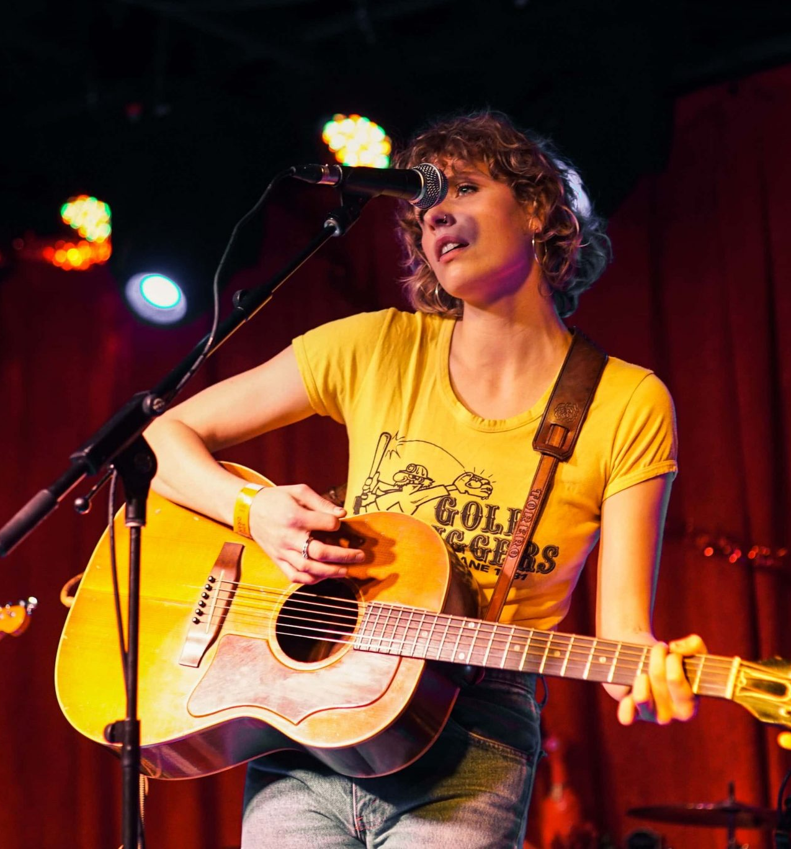
My favourite band
Complete the following information with your own favourite band.
Name:
Members (what do they do):
Country:
First and last album:
Genre:
Top three favourite songs:

Slide 3
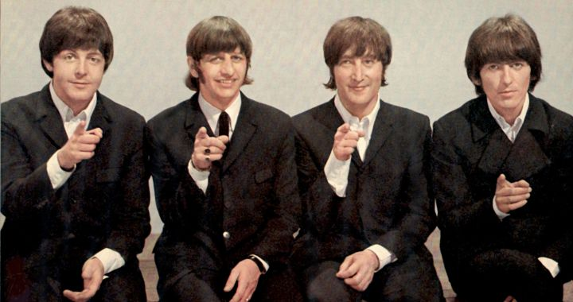
Example
My favourite band is The Beatles.
The members were John Lennon (rhytmic guitarist, vocalist), Paul McCartney (bassist, vocalist), George Harrison (guitarist, vocalist), and Ringo Starr (drummer, vocalist).
The band was formed in 1962 in Liverpool, England.
Their first album was “Please Please me”, released in 1963 and their last album was “Let it be” released in 1970.
My three favourite songs are: Blackbird, Here comes the sun, and Yellow Submarine

Slide 4
Please remember to answer everything in your notebook.

