Slide 1
The Structure of a Song
Daniel Salinas Lagos

Slide 2
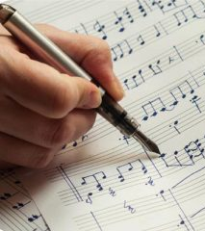
The Title and the Lyrics of a Song
The title is, in other words, the name of the song. Most of the time you can hear it in the chorus of the song. (e.g. Shape of You, Call me Maybe, etc)

Slide 3
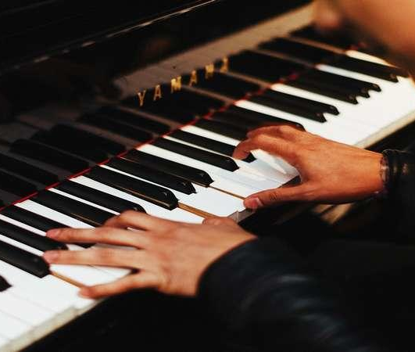
Intro
Think of the intro as a prelude of the actual song. It appears at the beginning of the song and set up your expectations about the song.
In other words, it is the instrumental part of the song before the verse.

Slide 4
Verse
This is the part of the song where the story begins to develop.
Most of the time, a song contains more than one verse with different lyrics (although the melody remains the same).

Slide 5
Pre-chorus
This section of the song is optional (some songs do not have it).
The main characteristic of this section is that it is typically repeated before each chorus in the song.
Its role most of the time is to build up suspense or anticipation before the chorus.

Slide 6
Chorus
This is the climax of the song. Here you will find the biggest energy.
This is also the catchiest part of the song and the one you keep singing after you listened the song.
Most of the time you find the title of the song in here.

Slide 7
Bridge
This section provides relief from the repetitive nature of many songs.
It has different lyrics from the ones you listened before in the verses and chorus.
Most of the time a song comes back to the chorus after singing the bridge.

Slide 8
Activity !
Choose a song you like.
In your notebook, write the lyrics of the song and identify the different sections we named before.
(I’ll show you an example)

