Slide 1
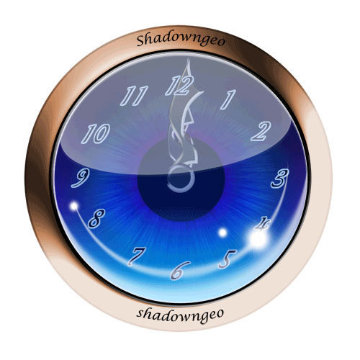
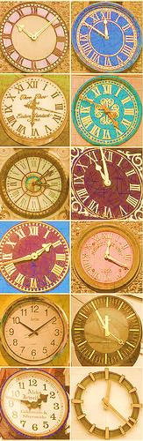
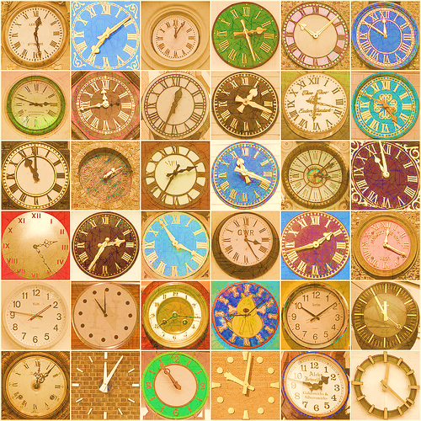
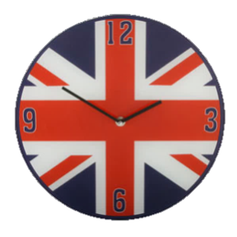



Slide 2




TO PAST
12
11
1
10
2
TELLING THE TIME
9
3
8
4
7
5
6

Slide 3
TO PAST
o’clock
five to
12
five past
11
1
ten to
10
2
ten past
a quarter to
9
3
a quarter past
8
4
twenty to
twenty past
7
5
6
twenty-five to
twenty-five past
half-past

Slide 4
12
11
1
10
2
9
3
8
4
7
5
6
It’s one o’clock

Slide 5
12
11
1
10
2
9
3
8
4
7
5
6
It’s five past nine

Slide 6
12
11
1
10
2
9
3
8
4
7
5
6
It’s ten past six

Slide 7
12
11
1
10
2
9
3
8
4
7
5
6
It’s a quarter past seven

Slide 8
12
11
1
10
2
9
3
8
4
7
5
6
It’s twenty past two

Slide 9
12
11
1
10
2
9
3
8
4
7
5
6
It’s twenty-five past eleven

Slide 10
12
11
1
10
2
9
3
8
4
7
5
6
It’s half-past three

Slide 11
12
11
1
10
2
9
3
8
4
7
5
6
It’s twenty-five to eight

Slide 12
12
11
1
10
2
9
3
8
4
7
5
6
It’s twenty to six

Slide 13
12
11
1
10
2
9
3
8
4
7
5
6
It’s a quarter to five

Slide 14
12
11
1
10
2
9
3
8
4
7
5
6
It’s ten to twelve

Slide 15
12
11
1
10
2
9
3
8
4
7
5
6
It’s five to four

Slide 16
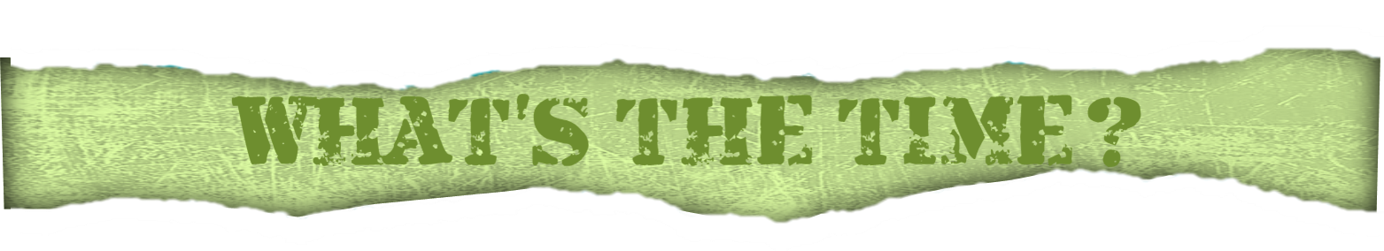
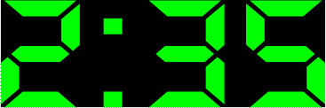
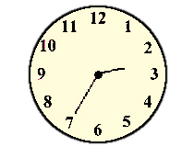
It’s …
twenty-five
to three
thirty-five
to two
NEXT

Slide 17
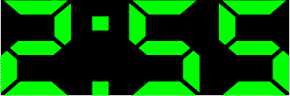
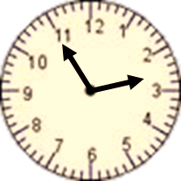
It’s …
fifty-five to two
five to three
NEXT

Slide 18
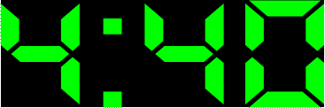
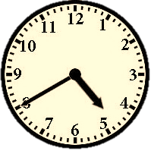
It’s …
twenty to five
twenty to four
NEXT

Slide 19
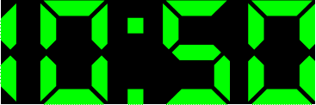
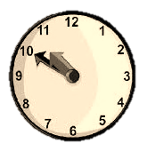
It’s …
fifty to ten
ten to eleven
NEXT

Slide 20
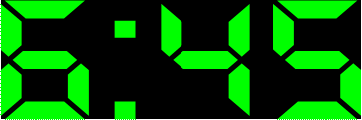
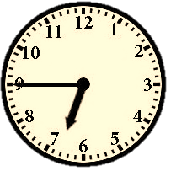
It’s …
a quarter
to six
a quarter
to seven
EXIT

