Slide 1
COMPARATIVES AND SUPERLATIVES

Slide 3
Comparando
Al comparar utilizamos dos o más objetos o personas.
Para comparar utilizamos ADJETIVOS para dar cualidades a los objetos.
Adjetivos tales como
Grande/Big
Lindo/Pretty
Hermoso/Beautiful
Alto/Tall
Interesante/Interesting.

Slide 4
En español, al comparar creamos oraciones tales como:
Santiago es más grande que Rancagua
Grande/Big
(Big= 1 syllable)
Bon Jovi es más viejo que Justin Bieber
Viejo= Old
Old= 1 syllable
Santiago is bigger than Rancagua
Bon Jovi is older than Justin Bieber

Slide 5
El sur es más hermoso que el Norte
La ficción es más interesante que la historia
Fictions is more interesting than history
Interesante/interesting= 4 syllables
The south is more beautiful than the North

Slide 6
COMPARATIVES I
Short →1,2 syllables
(tall, rich, poor)
Adj.-ER + THAN
Adjectives
Long→ 2 or more syllables (polite, interesting, horrible)
MORE/LESS + Adj. + THAN

Slide 7
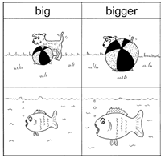
COMPARATIVES II
Sam is big.
The ball is bigger than Sam.
Colin is big.
Rodin is bigger than Colin.
SAM
COLIN
RODIN

Slide 8
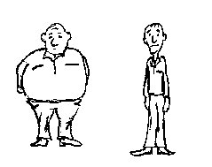
COMPARATIVES Iv
George is _____ (fat) ____ David.
David is _____(thin) ____ George.
I’m George
I’m David

Slide 9
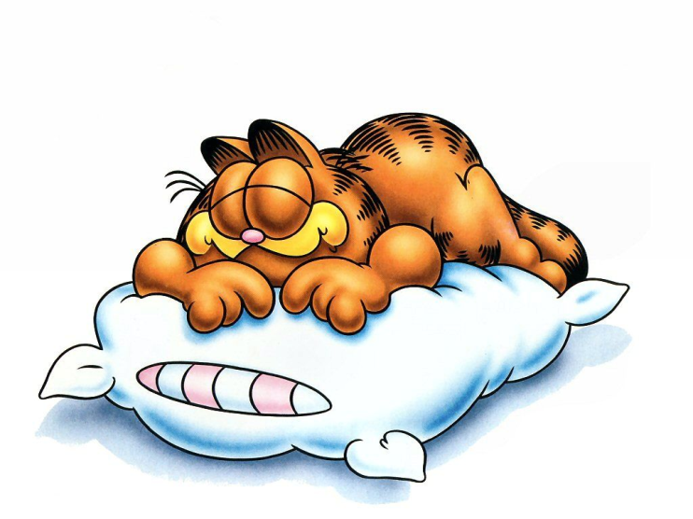
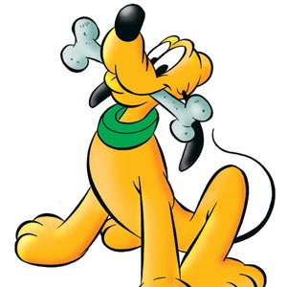
COMPARATIVES v
The cat is ______(lazy) _____ the dog.

Slide 10
COMPARATIVES Vi
-Big
-Long
-Young
-Nice
-Dangerous
COCO
TOBY

Slide 11
COMPARATIVES AND SUPERLATIVES

Slide 12
Superlatives i
Short →1,2 syllables
(tall, rich, poor)
THE + Adj.-EST
The tallest house
The richest man
Adjectives
Long→ 2 or more syllables (polite, interesting, horrible)
THE+ MOST/ + Adj.
The most beautiful garden
The most expensive book

Slide 13
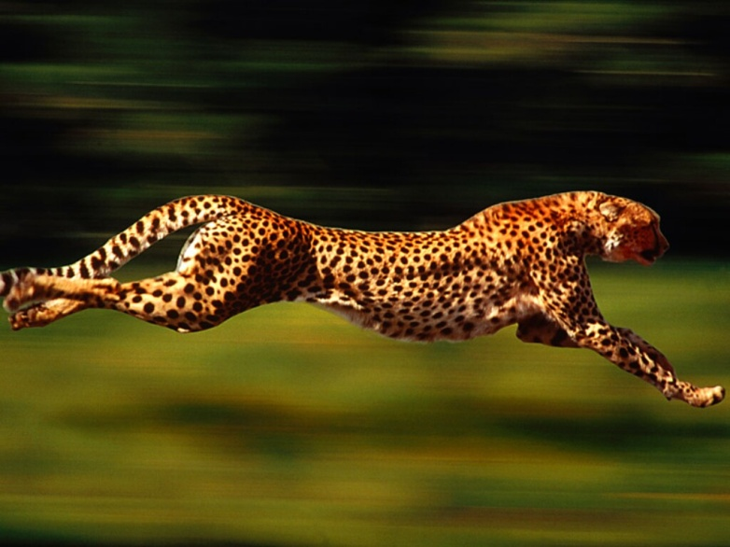
Superlatives ii
The Nile is ___ ______(long) river in the world.
The blue whale is the largest (large) animal in the world.
A cheetah is ___ ______ (fast) animal in the world.

Slide 14
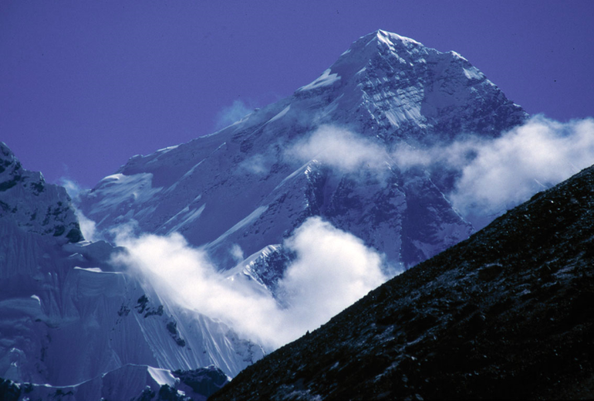
Superlatives iv
Mexico City is ___ _______ (big) city in the world.
The gold is the heaviest (heavy) metal.
Africa is ___ ______(hot) place in the world.
Antarctica is ___ _____ (cold) place in the world.
Asia is ___ _______ (large) continent.
Mount Everest is
___ _____ (high)
mountain in the world.

Slide 15
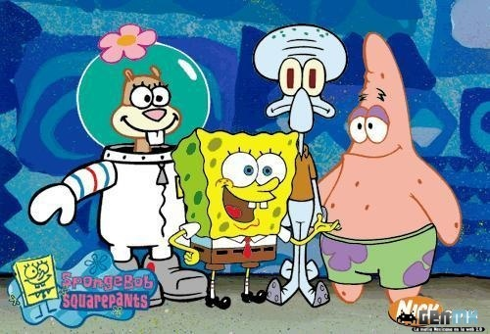
Superlatives vI
Who is the funniest character?
Who is the most interesting?
Who is the heaviest?
Who has the biggest nose?
Who is the most intelligent?
Who is the best character?

Slide 16
Comparatives and superlatives

Slide 17
Exceptions
Good= better than= the best
Bad= worse than = the worst
Far= farther/further than = the farthest/ the furthest
Much= more than = the most
Si el adjetivo termina en “ing” su superlativo siempre se hará agregando la palabra “the most”
Boring= the most boring

