Slide 1
PRESENT PERFECT CONTINUOUS
I HAVE BEEN + Ving

Slide 2
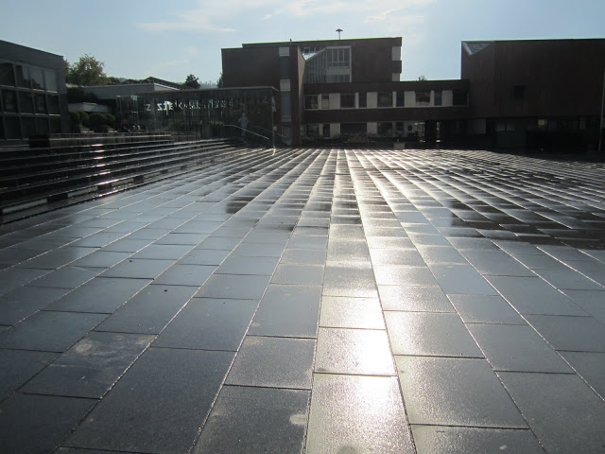
Study this situation:
Is it raining?
No, but the ground is wet.
It has been raining.
Have / has been Ving is the present perfect continuous.

Slide 3
I/you/we/they HAVE BEEN Ving
He/she/it HAS BEEN Ving

Slide 4
When do we use it?
We use the present perfect continuous for an activity that has recently stopped or just stopped. There is a connection with now!
You are out of breath. Have you been running? (=you are out of breath NOW)
Paul is very tired. He has been working very hard. (=he is tired now)

Slide 5
Study this situation:
It began raining two hours ago and it is still raining.
How long has it been raining? It has been raining for two hours.
We use the present perfect continuous in this way with how long, for ..... and since.... The activity is still happening (as in the example) or has just stopped.

Slide 6
The present perfect continuous is often use with words and phrases like all day/week/year/etc, for, since, just, etc.
As well as for actions repeated over a period of time.
How long have you been learning English? (=you are still learning it)
Tom is still watching TV. He’s been watching TV all day.
Where have you been? I have been looking for you the last half hour!
We have been walking for hours and I need a rest!
Every morning they meet in the same cafe. They have been going there for years.

