Slide 1
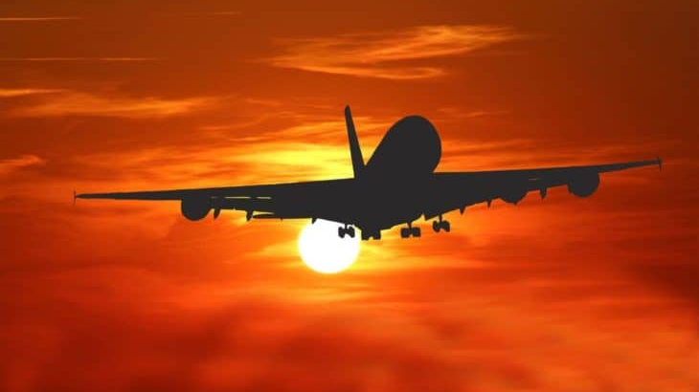
The Use of “Going to”
Daniel Salinas Lagos
8vo básico
Colegio Cristiano Emmanuel

Slide 2
Why do we use “going to”?
We use “going to” to talk about our future plans and intentions. (Usually the decision about the future plans has already been made)
For example,
I’m going to travel to Rome by plane this weekend
I’m going to do some sightseeing tomorrow with my friend Mike
I’m going to take a holiday next week
You can also talk about other people’s future plans. For example,
Sabrina (she) is going to go hiking tomorrow
Thomas (he) is going to arrive from Europe next Friday

Slide 3
How do we use it?
To make sentences using “going to”, we follow the next structure:
Subject + Verb to be + “going to” + verb (inf) + complement
I am going to do some sightseeing
I Am
You
We Are
They
She
He Is
It

Slide 5
Complete the dialogue with the verb “to be” + “going to”
A: What are you going to do today?
B: I _______________ work with my dad. Why?
A: I wanted to know.
B: Why? Did you have any plans?
A: Yes, I _________________ go to the cinema with some friends and I thought you might want to come.
B: Is your friend Sofia going to go?.
A: Yes, she _______________ come with us.
B: I _____________ talk with my dad and see if I can make it. Which time are you going to go?
A: We _______________ meet at the cinema at 6:30 but the movie starts at 7:00.
B: I ________________ arrive at 6:45. Is that okay?
A: Yes, that’s perfect. See you there.

Slide 6
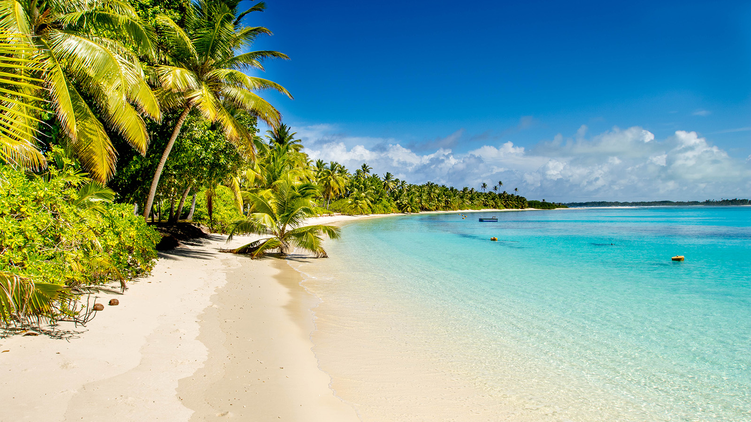
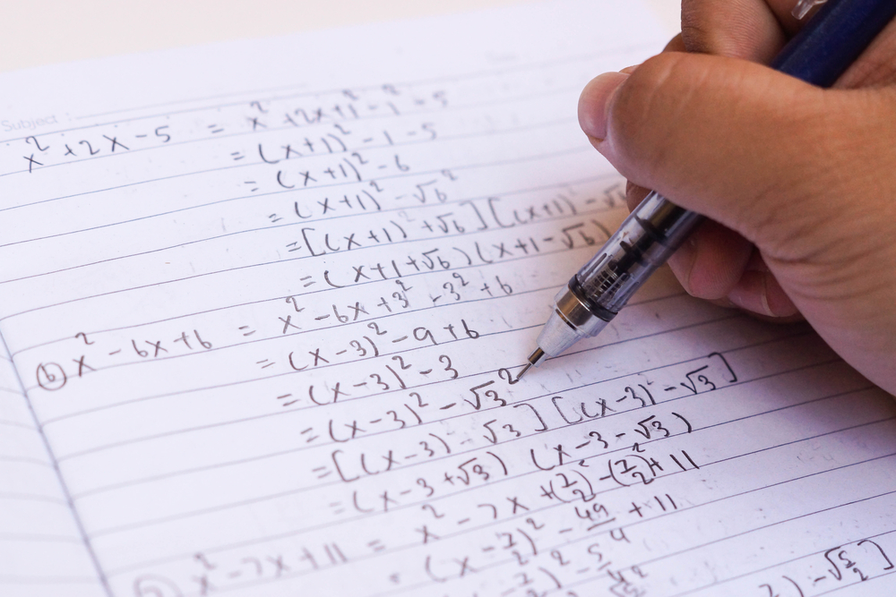
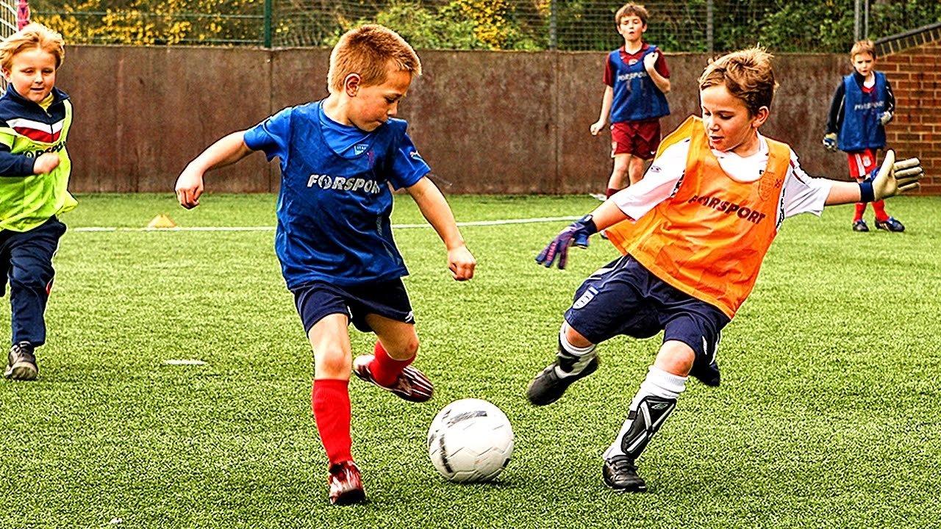
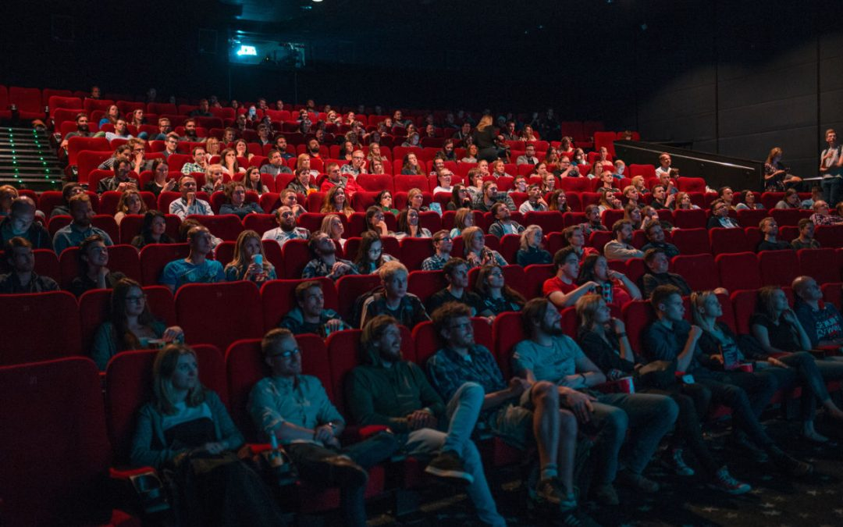
Make sentences according to the picture
1)
2)
______________________________________
______________________________________
3)
4)
______________________________________
______________________________________

