Slide 1
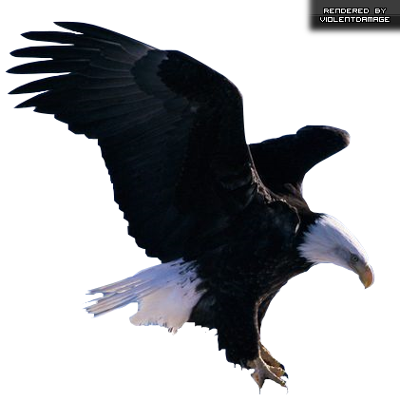
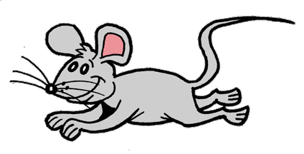
A-an: un,uno,una
An eagle
A mouse

Slide 2
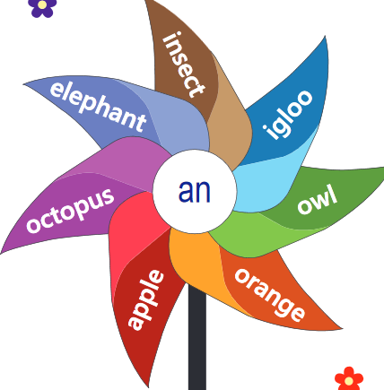
An
Vowels
A E I O U
When the object we are talking about starts with a vowel (ex: ant, octopus, elephant) we use “an”.
An ant
An octopus
An elephant
An hour
An island

Slide 3
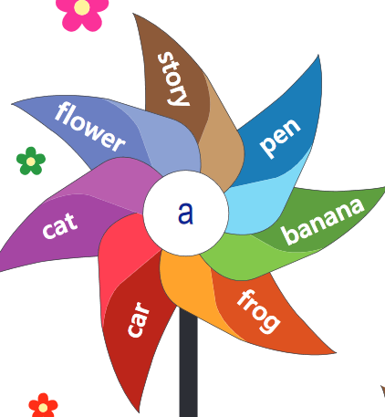
2. A
When the object start with a consonant (ex: dog, bunny, girl), we use “a”.
A dog
A cat
A house
A plane
A chocolate

Slide 4
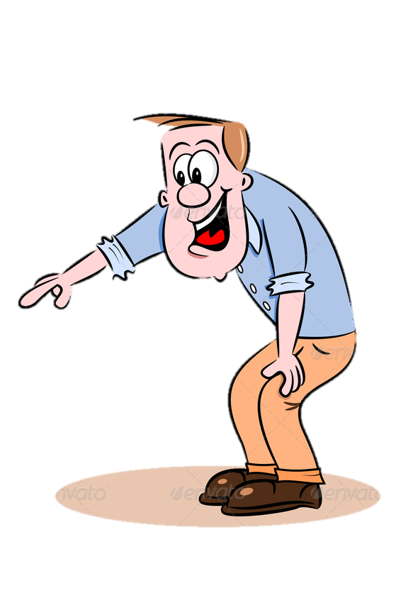
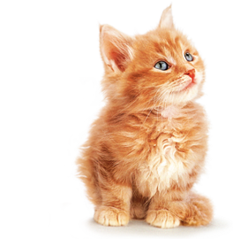
“I see ___ cat!”
a

Slide 5
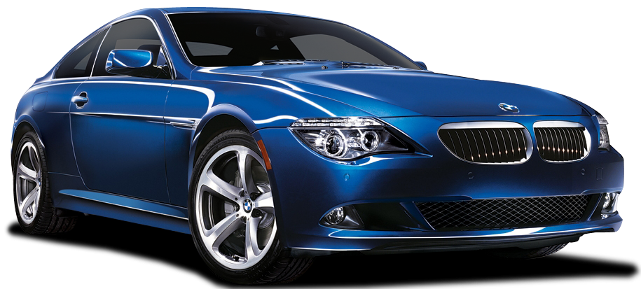
“I see ___ car!”
a

Slide 6
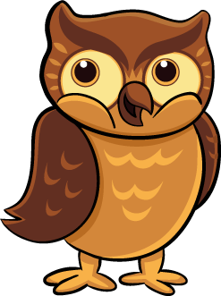
“I see ___ owl!”
an

Slide 7
“I see ___ eagle!”
an

Slide 9
Write this activity in your notebook and complete with “a” or “an”
____ usual feeling ____ interest ____ alibi ____ early bird ____ couch ____ airplane ____ grade ____ pair ____ idea ____ energy level
____ bingo game
____ idiot
____ good job
____ rotten plum
____ used fork
____ uncle
____ fine opera
____ television
____ earthquake
____ icicle
____ plant
____ eggplant

